Slide 1
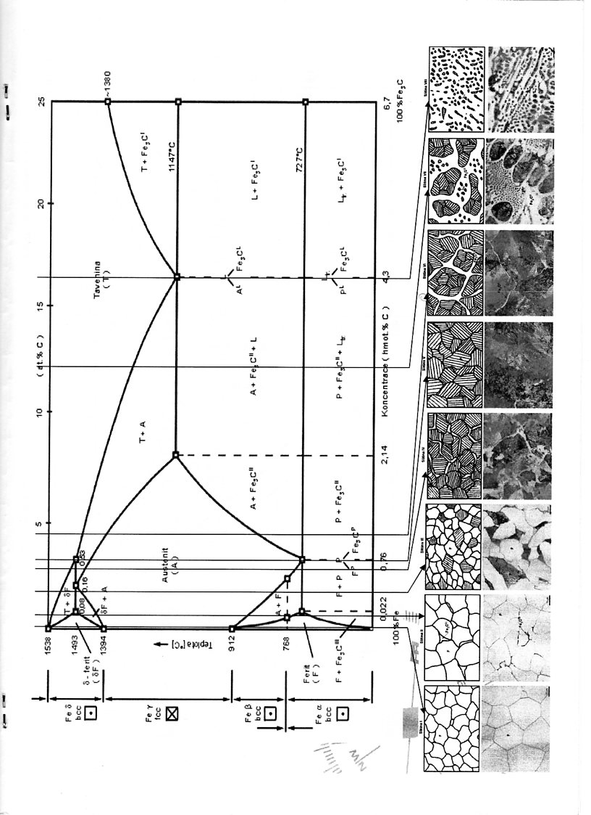

Slide 2
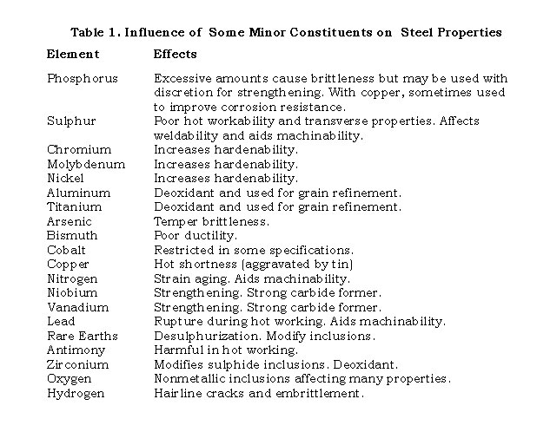

Slide 3
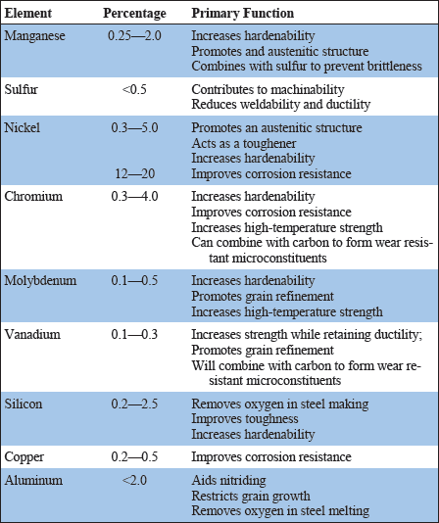

Slide 4
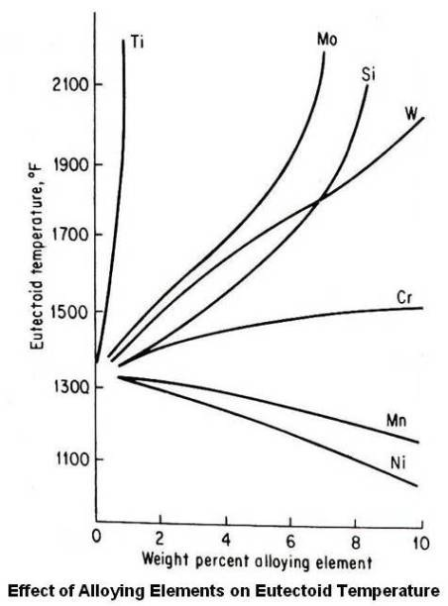

Slide 5
Influence of alloying elements on Fe binary diagram

Slide 6
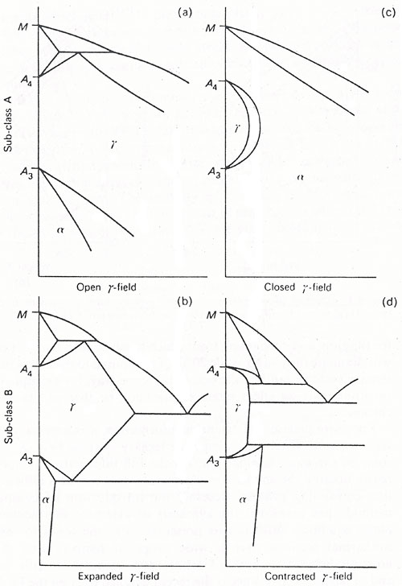
Ni, Mn, Co, …
Si, Al, Cr, Ti, V, Be
B, Nb, Zr, Ta
C, N

Slide 8
Microalloying

Slide 9
Microalloying
Effect on grain refining (retards movability of grain boundaries)
increased yield strength and toughness
Precipitation strengthening
Conc: 0. 01- 0.1 wt. %

Slide 10
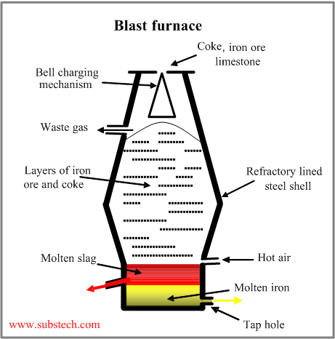
Extractive metallurgy of iron
Iron ores (magnetite, hematite)
– iron oxides with earth impurities;
Coke, which is both reducing agent and fuel, providing heat for melting the metal and slag.
Coke is produced from coking coals by heating them away from air.
Limestone – calcium silicate fluxes, forming a fluid slag for removal gangue from the ore.
2C + O₂= 2CO
3Fe₂O₃ + CO = 2Fe₃O₄ + CO₂
Fe₃O₄ + CO = 3FeO + CO₂
FeO + CO = Fe + CO₂
Dr. Dmitri Kopeliovich

Slide 11
Steel making

Slide 12
EAF process

Slide 13
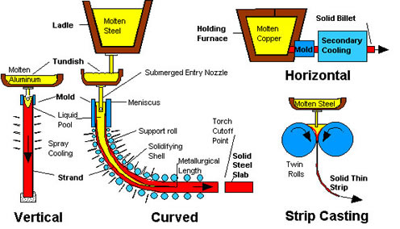
Coninuous casting

Slide 14
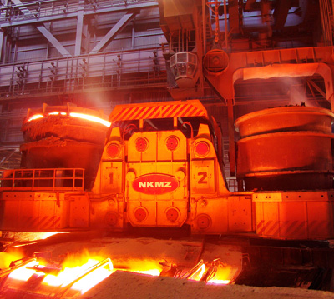
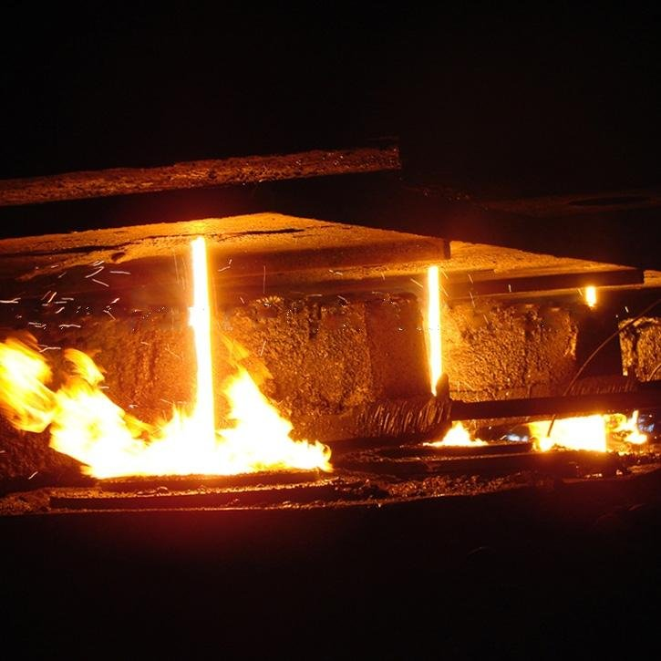
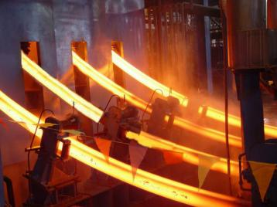

Slide 15
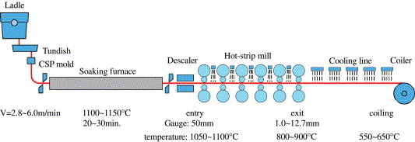
Casting – Pressing – Rolling – (CPR)

Slide 17
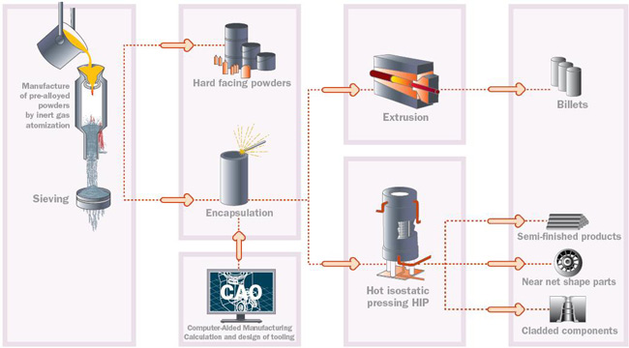
Powder metallurgy

