Slide 1
Contents of Work Package DP2 WP02 Damping of Vertical and Horizontal Vibrations in Vehicle Suspensions
WP02: Damping of Vertical and Horizontal Vibrations in Vehicle Suspensions
Coordinator of the WP
Czech Technical University in Prague, responsible person Ing. Zdeněk Neusser, PhD.
Participants of the WP
Brano a.s. R. Valášek, Vysoké učení technické v Brně I. Mazurek, Univerzita Pardubice A. Hába, Strojírna Oslavany spol. s.r.o. M. Daniel
Main Goal of the WP
2-WP02-002: Modular semi-active damper for application in railway vehicle bogie. Development of modular semi-active damper is used for railway vehicle properties optimization to reduce vibrations due to the rail unevenness.
2-WP02-004: Telescopic shock absorber with variable damping reacting to changes of vehicle load. Such telescopic shock absorber for car industry increases passenger comfort and reduces effect of vibrations coming from the road bumps and unevenness.
Notes:
1

Slide 2
Contents of Work Package DP2 WP02 Damping of Vertical and Horizontal Vibrations in Vehicle Suspensions
WP02: Damping of Vertical and Horizontal Vibrations in Vehicle Suspensions
Partial Goals for the Current Period
2-WP02-001: Controller for semi-active damper. The development of controller meets the project plan. Outcome is planned to 6/2020.
2-WP02-002: Create a timeless production program of semi-active dampers for railway vehicles. The production program will be applied in company ST-OS. The development of damper meets the project plan. Outcome is planned to 12/2019 and the functional sample is finished.
2-WP02-003: Simulation verification of the semi-active damping benefits in the bogie of electric locomotive. Simulation progress meets the project plan. Outcome is planned to 12/2020.
2-WP02-004: Research and conceptual design development of telescopic shock absorber with passive damping changes with response to vehicle load and vibrations.
2-WP02-005: Papers/conferences related to semi-active damping are prepared continuously according to the plan. Two papers will be released till 12/2020.
Notes:
2

Slide 3
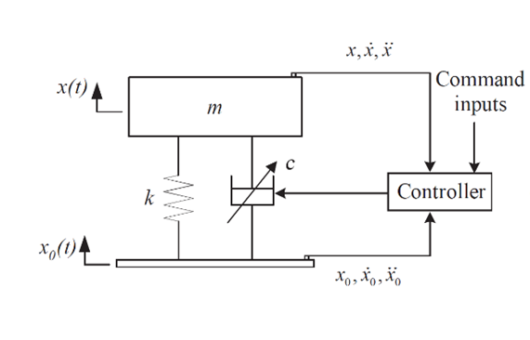
2-WP02-002 Development of modular semi-active damper for application in railway vehicle bogie: Introduction
Semiactive control: Variable damping force
ON/OFF Skyhook
$$\dot{x}∙\left(\dot{x}−{\dot{x}}_{0}\right)≥0 →c=c_{max}$$
$$\dot{x}∙\left(\dot{x}−{\dot{x}}_{0}\right)<0 →c=c_{min}$$
Notes:
3

Slide 4
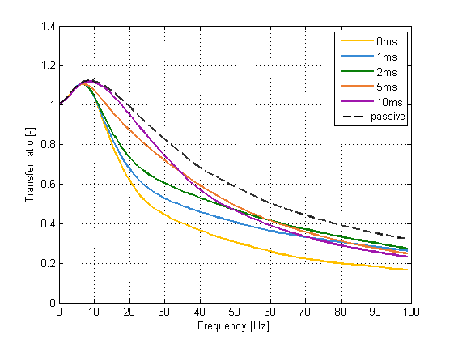
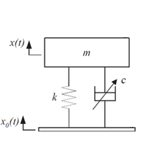
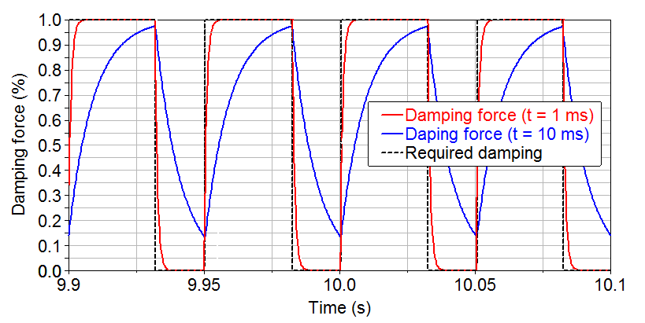
2-WP02-002 Development of modular semi-active damper for application in railway vehicle bogie: Introduction
Response time influence on semiactive vibration isolation
$$T\left(f\right)= \frac{x(f)}{x_{0}(f)}$$
Notes:
4

Slide 5
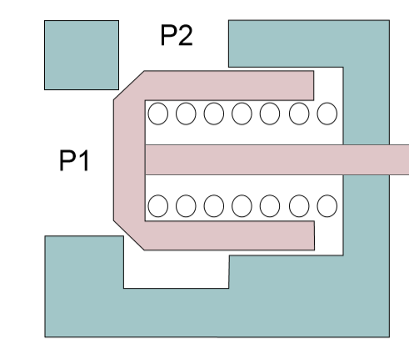
2-WP02-002 Development of modular semi-active damper for application in railway vehicle bogie: Introduction
Valve of convencional damper
Limited acceleration of valve
$$m$$
$$F=m∙a$$
Notes:
5

Slide 6
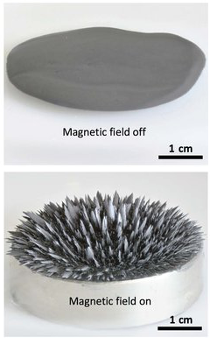
2-WP02-002 Development of modular semi-active damper for application in railway vehicle bogie: Magnetorheological (MR) technology
MR fluid MR damper
Notes:
6

Slide 7
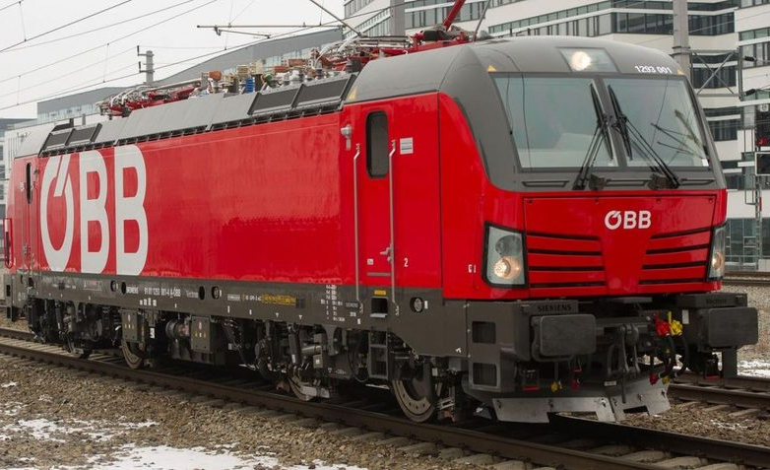
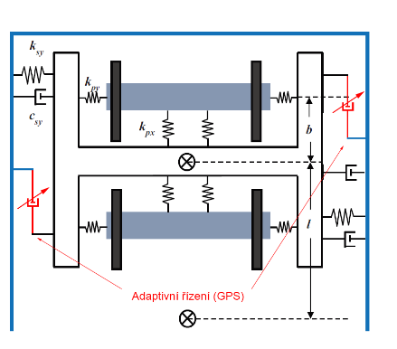
2-WP02-002 Development of modular semi-active damper for application in railway vehicle bogie: Railway vehicle application
Yaw damper
Required
trajectory
Převzato z https://zdopravy.cz/
Semi-active control
Notes:
7

Slide 8
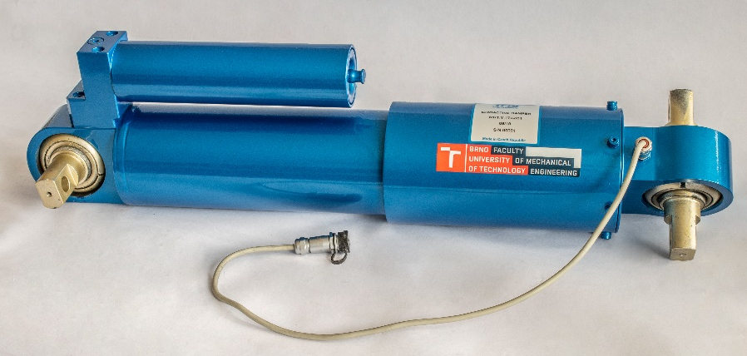
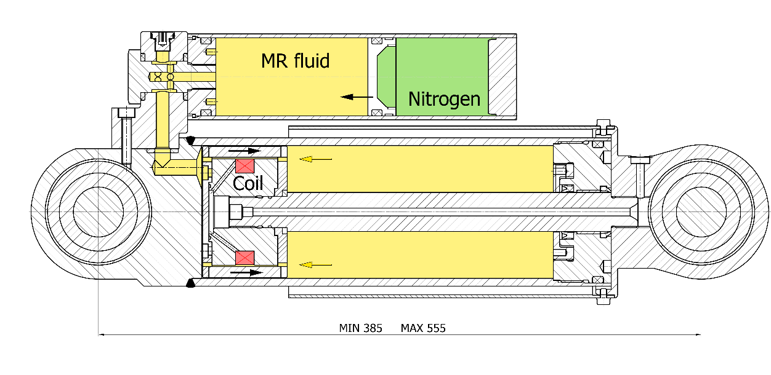
2-WP02-002 Development of modular semi-active damper for application in railway vehicle bogie: MR damper for railway application
Yaw damper
Damping force: 0-20 kN
MR fluid volume: 1,05 l
Response time: 30 ms
Power input: 15 W
Notes:
8

Slide 9
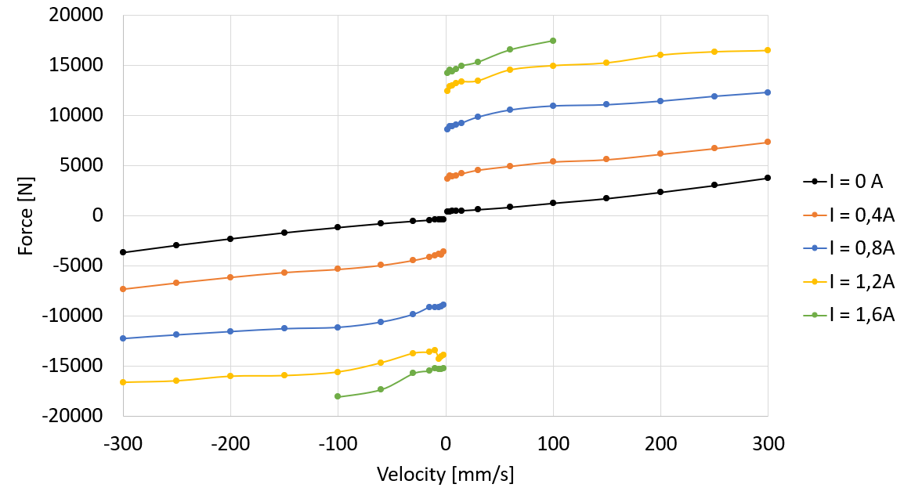
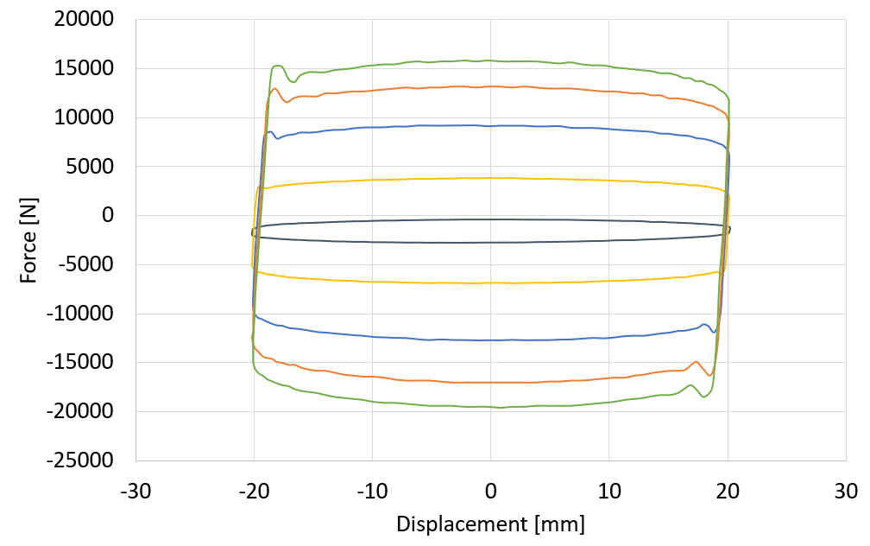
2-WP02-002 Development of modular semi-active damper for application in railway vehicle bogie: Measurement of damping force
Force velocity dependency
(stroke ± 20 mm)
Force displacement dependency
(piston velocity ± 0.1 m/s)
Notes:
9

Slide 10
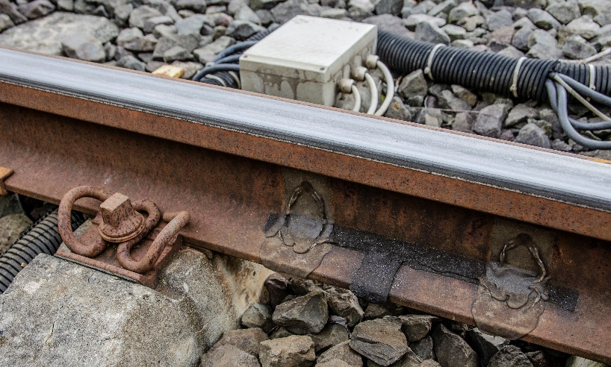
2-WP02-002 Development of modular semi-active damper for application in railway vehicle bogie: In-service tests
Vehicle speed: v = 25; 40 km/h
Test track: Minden, Germany
R 190m
Notes:
10

Slide 11
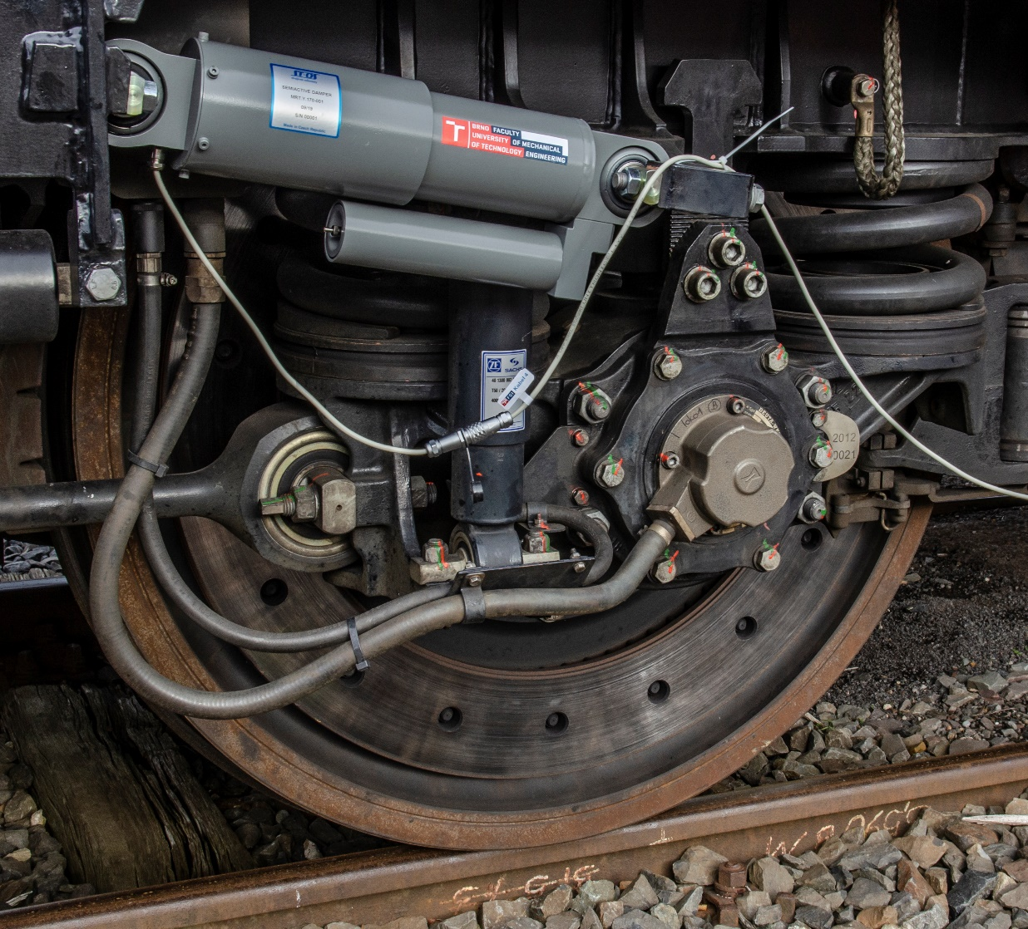
2-WP02-002 Development of modular semi-active damper for application in railway vehicle bogie: In-service tests
Notes:
11

Slide 12
2-WP02-002 Development of modular semi-active damper for application in railway vehicle bogie: In-service tests
Deformation of the damper
Deformation velocity of the damper
Notes:
12

Slide 13
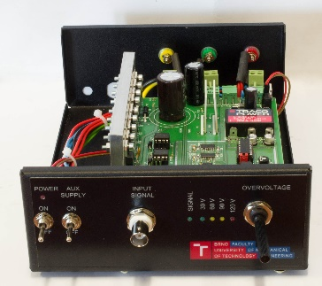
2-WP02-002 Development of modular semi-active damper for application in railway vehicle bogie: Future goal: MR damper with short time response
Response time sources:
current rise (current controler)
Response time: 0.3 ms
time response of MR fluid itself
time response: 0.6 ms
eddy current in coil core
time response: 30 ms
No. 304636
Junior Grant 2020
Notes:
13

Slide 14
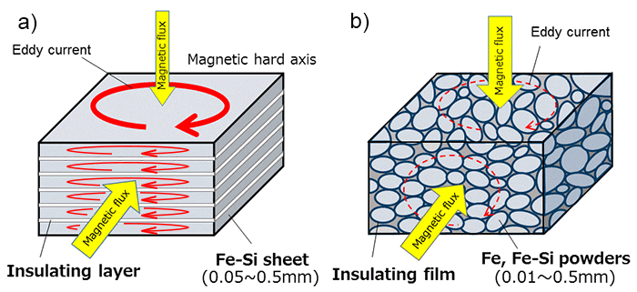
2-WP02-002 Development of modular semi-active damper for application in railway vehicle bogie: Future goal: MR damper with short time response
Shape approach
Material approach
Notes:
14

Slide 15
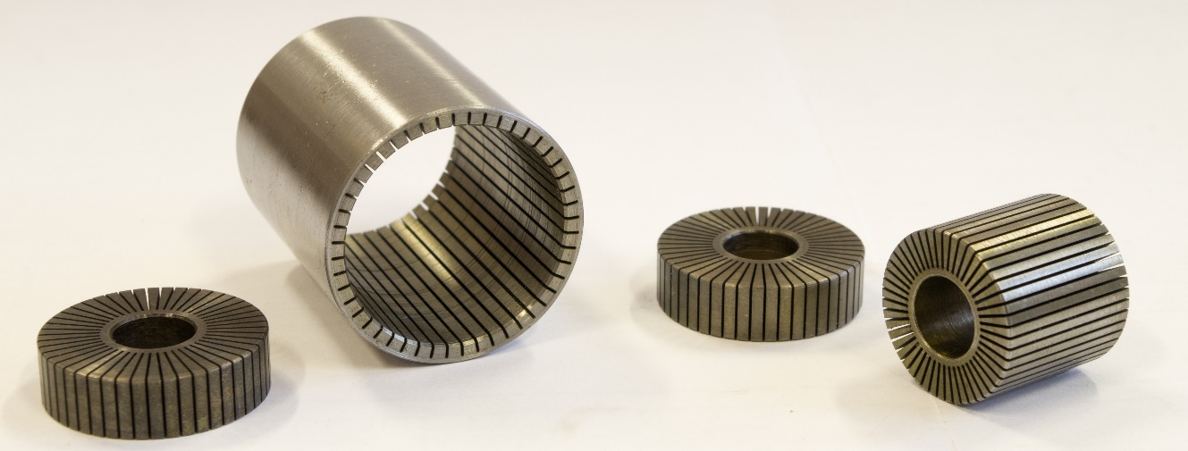
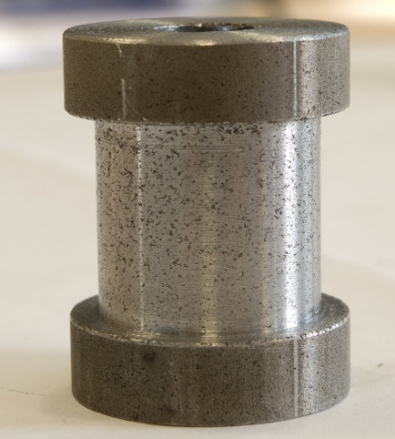
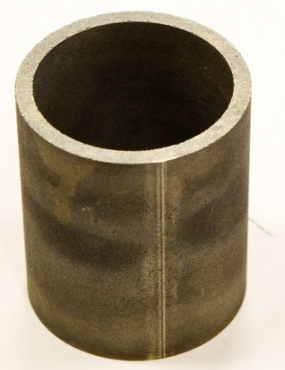
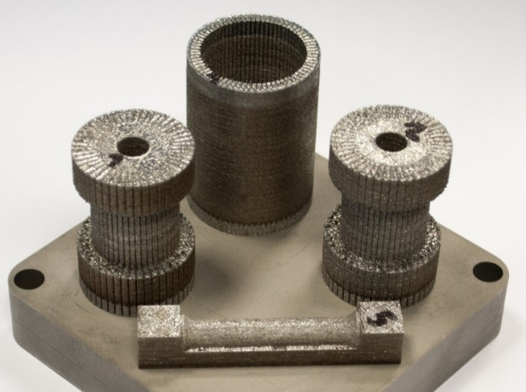
2-WP02-002 Development of modular semi-active damper for application in railway vehicle bogie: Future goal: MR damper with short time response
Material approach
Shape approach
EP3092421A1
Notes:
15

Slide 16
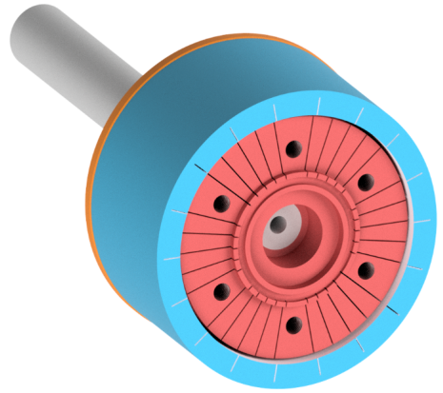
2-WP02-002 Development of modular semi-active damper for application in railway vehicle bogie: Future goal: MR damper with short time response
No grooves
30 grooves in coil core
19 grooves in coil cylinder
Time response: 30 ms
Groove width: 0,35 mm
Response time: 4 ms (simulation)
Notes:
16

Slide 17
2-WP02-004 Development of telescopic shock absorber with variable damping reacting to changes of vehicle load: Introduction
Modification of shock absorber characteristics
In order to increase the comfort of the driver / passengers
Reduction of forces / impact forces on the body and road
Passive variant
Maintenance-free variants
No energy requirements
Price
Mechanical losses, wear of components
Active variant
Possibility of intervention and adaptive intervention
Adjustment of damper characteristics according to inputs and other requirements
Active elements - servomotors, coils, ...
Notes:
17

Slide 18
2-WP02-004 Development of telescopic shock absorber with variable damping reacting to changes of vehicle load: Specification of adaptive shock absorber requirements
Comfort zone for the driver
Passive solutions
Use of serial shock absorbers
Without interfering with the existing built-up area
Minimization of increased production costs
zone of strong damping
X
comfort zone
|b|
x
Notes:
18

Slide 19
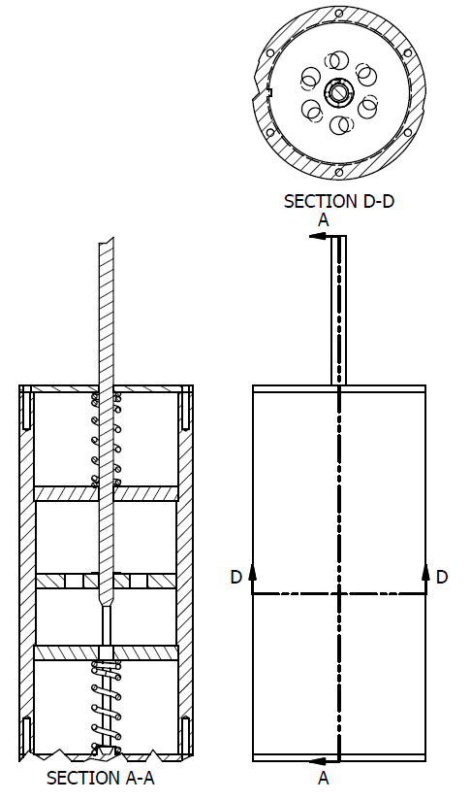
2-WP02-004 Development of telescopic shock absorber with variable damping reacting to changes of vehicle load: suggestion of solution 1
Small displacements
the working piston moves in the region between the two auxiliary valves
the oil flows only through the primary valve
Designed for low damping power - increased comfort
Large displacements
The primary piston picks up an additional valve thereby reducing the flow - damping force is greatest
By the number and rotation of the flow rates in the individual valves, the damping force can be adjusted
Cover of primary and auxiliary valve
Auxiliary valves
Primary valve
Notes:
19

Slide 20
2-WP02-004 Development of telescopic shock absorber with variable damping reacting to changes of vehicle load: suggestion of solution 2
Small displacements
the working piston moves in the region between the two grooves
the oil flows not only through the piston valves, but also through the grooves
this additional bypass reduces the damping force - higher comfort
Large displacements
the working piston moves below the groove so that no additional flow cross section is present and the damping force is greatest
the damping force can be adapted to the number and length of the grooves and their relative offset
Notes:
20

Slide 21
2-WP02-004 Development of telescopic shock absorber with variable damping reacting to changes of vehicle load: suggestion of solution 3
Small displacements
the working piston moves in the region between the additional flow
the oil flows not only through the piston valves, but also by-pass
this additional bypass reduces the damping force - higher comfort
Large displacements
the working piston moves below the bypass so that no additional flow cross-section is present and the damping force is greatest
the damping force can be adapted to the number and length and thickness of the bypass
Notes:
21

Slide 22
2-WP02-004 Development of telescopic shock absorber with variable damping reacting to changes of vehicle load: suggestion of solution 4
Small displacements
the working piston moves in the narrowed seal area
the oil flows not only through the piston valves, but also through the seal
this additional flow reduces the damping force - higher comfort
Large displacements
the working piston moves in the full seal area so that no additional flow cross-section is present and the damping force is highest
The damping force can be adapted to the number and length and thickness of the seals
Notes:
22

Slide 23
2-WP02-004 Development of telescopic shock absorber with variable damping reacting to changes of vehicle load: Variant no. 2 selection
The easiest construction
The least expensive implementation
The lowest risk of defects in the operation of dampers
Less controllable damping parameters
Notes:
23

Slide 24
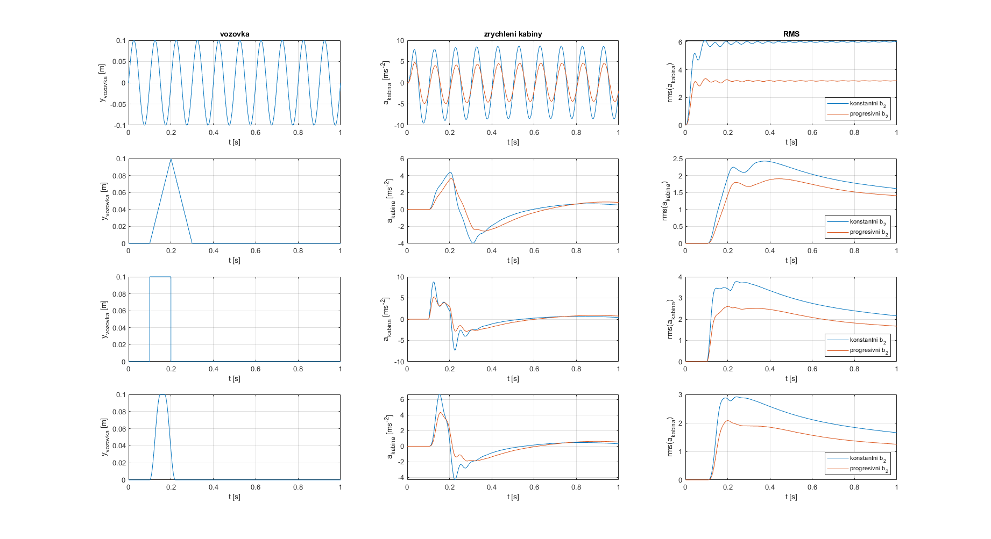
2-WP02-004 Development of telescopic shock absorber with variable damping reacting to changes of vehicle load: Selected variant simulation experiment
driver's cab
k₂
b₂
frame
k₁
b₁
tire
k_{p}
Notes:
24

Slide 25
Fulfillment of goals and deliverables of DP2 WP02 Damping of Vertical and Horizontal Vibrations in Vehicle Suspensions
Current State of Deliverables, Milestones and Fulfillment of Goals
The milestone 2-WP02-002 Modular semi-active damper for application in railway vehicle bogie is finished and functional sample is assembled and tested. The 2-WP02-001 Controller for semi-active damper is under the development and is related with damper tests and measurements. Simulations for 2-WP02-003 Simulation verification of the semi-active damping benefits in the bogie of electric locomotive are realized in parallel with hardware development, the model is adjusted to be in acceptance with measurement. Publications in 2-WP02-005 Papers/conferences related to semi-active damping are planned and material is collected from the experiences from other milestones.
The damper 2-WP02-004 Telescopic shock absorber with variable damping reacting to changes of vehicle load development is in the conceptual and simulation verification phase. Selected concept (which is going to be realized as functional sample) is selected and simulation is performed.
List of Due Deliverables and Their Added Value
The outcome TN01000026/2-V5 entitled 2-WP02-002 Modular semi-active damper for application in railway vehicle bogie is finished as a functional sample. Developed damper is going to be in service railway producers participating on the project (e.g. Škoda). It helps to optimize driving properties of the related vehicle.
Notes:
25

Slide 26
Current contribution of DP2 WP02 Damping of Vertical and Horizontal Vibrations in Vehicle Suspensions
Assessment of the Contribution of Deliverables
Developed dampers are going to be in service railway and car producers participating on the project (e.g. Škoda). It helps to optimize driving properties of the related vehicles. The reduction of the accelerations to the vehicle body and to the road/track decreases their damage and failures during the transport. It increases the road persistence and reduces damage occurrence of the transported goods and increases passenger comfort.
Notes:
26

Slide 27
Acknowledgement
This research has been realized using the support of Technological Agency, Czech Republic, programme National Competence Centres, project #TN01000026 Josef Bozek National Center of Competence for Surface Vehicles. This support is gratefully acknowledged.
Notes:
27

Slide 28
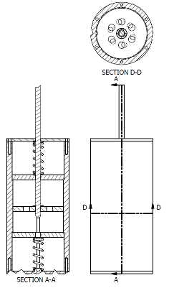
Abstract of works on DP2 WP02 Damping of Vertical and Horizontal Vibrations in Vehicle Suspensions
Modular semi-active damper for application in railway vehicle bogie is developed, assembled and tested at railway test ring. The behavior is smooth and accelerations are reduced.
Development of telescopic shock absorber for small lorries with variable damping reacting to changes of vehicle load, passive. Target: driving comfort.
zone of strong damping – heavy load
X
Comfort zone – medium or no load
Specification of desired behaviour
Concepts of realization
Simulation experiment
Notes:
28

Slide 29
Výtah z provedených prací na DP2 WP02 Damping of Vertical and Horizontal Vibrations in Vehicle Suspensions
Modulární poloaktivní tlumič pro aplikaci na železniční podvozky je dovyvinut, první vzorek je složen a otestován. Tlumič vykazuje hladké průběhy veličin a snížené vibrace.
Výzkum a vývoj tlumiče pro malé nákladní vozy s proměnnou tlumící charakteristikou reagující na zátěž vozidla. Pasivní řešení. Cílem je lepší pohodlí řidiče.
zone of strong damping – heavy load
X
Comfort zone – medium or no load
Specifikace požadovaných vlastností
Koncepty řešení
Simulační experiment
Notes:
29

