Slide 1
RZ10
Žitný BC project for Glasgow students 2015 (frozen since September 2015)
Metzner White convergent/divergent Gauss planar channel flow
GAČR = kolagen
Motto: It is a big mistake for teachers that they do not ask students about their dreams and ideas before creative genes of pure-minded students came under the tutelage of tutors. And an even bigger mistake is when the students afraid to talk about their crazy ideas.

Slide 2
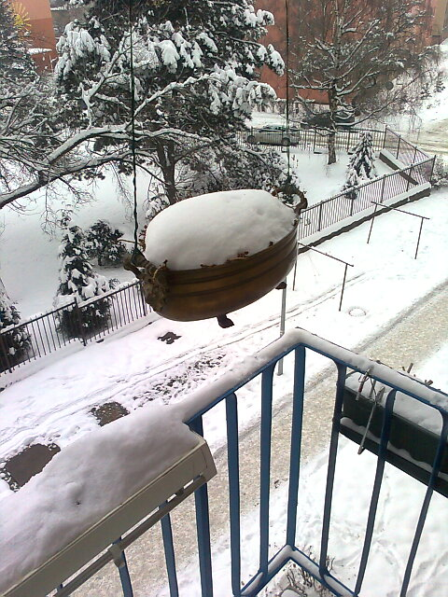
History of project
The idea, how to determine the relaxation time of viscoelastic fluid by comparing the pressure drop at elongation and compression flows in a converging/diverging slot, think about everyone after reading the first book about rheology. The problem is in a technical realization of viscoelastic stresses measurement along a channel with a variable cross section: Possible solution was to use the concept of groove strain-gauge sensors for measuring the axial pressure profile in the annular gap of existing extrusion rheometer (the development of these sensors was implemented from the beginning of the seventies). The first practical experiments (convergent/divergent gap between the cylindrical tube with attached sensors and internal double-cone pin) were up in the early nineties. Relevant results were summarized in Pavlovec thesis (theoretical solution assuming the analytic velocity profiles corresponding to a power fluid flow and numerical solutions of viscoelastic fluid type Metzner White) and in thesis by Zeleny (experiment with collagen and a double-cone pin - certain differences in pressure losses in the convergent/divergent slit were recorded). Mr. Pavlovec was an excellent student, but its thesis has not been completed (Fortran programs did not converged and the result was reduced to extremely simplified 1D analysis). The problem is simply too complicated for single student without sufficient background.
And that is the true goal of this presentation: to prepare a groundwork for english speaking students from Glasgow.

Slide 3
History of project
Previous presentation RZ8 was almost duplicated thesis of Pavlovec, programmed in MATLAB with certain exemptions in differencing (but basic simplification consisting in using the power law velocity profile, was preserved). Although solutions converge, the results raise some doubts, especially the occurrence of strange peaks of calculated pressures in the axis of the channel and also the unexpected effect of elasticity: Pressure loss in the convergent section was lower than in the divergent section (see following sheet No. 13). Independent solutions and programming performed by student (Mr. Frouz) reportedly received identical results (presented at the Students Conference). Still, I'd be very happy if he could express his findings in the form of diagrams on a slide 13, so that a consensus was evident.
The following diagram is a visualization of what's happening with a loaded fiber. According to this concept the normal stress on the wall should be lower than during the stretching of the fiber during its compression. But it is at odds with the results of the model (see sheet 7).
Stretched fiber
Compressed fiber
Equilibrium fiber
This visualization is perhaps misleading (it say that the normal stress in the zone of elongation is less than in the compression zone), because the de-facto ignores the influence of time. I will be grateful to anyone who offers a better interpretation of what was really going on polymer fibers.

Slide 4
History of project discussion of simplifying assumptions (assumed velocity profile not affected by elastic forces)
RZ8 model assuming linear cross-sectional profile of convergent/divergent slots along with the assumption of a power law velocity profile actually result to a discontinuity of elongation rate (positive constant rate of elongation in the convergent zone while a constant negative rate in the divergent zone). The discontinuity and weak singularity at the transition may cause unrealistic peak pressures and inaccuracies axial profile of normal stresses.
These fundamental shortcomings could be eliminated using the model described in this presentation. The axial cross-sectional profile channel (and therefore the rate of elongation) is a smooth function (Gaussian curve), and the velocity field is calculated (based on the concept of the current function and vorticity). Technically speaking, the manufacture of the walls with the Gaussian profile should be no problem (using rapid prototyping - the geometry of the channel varies exchanging inserts, which must anyway be of non-conductive plastic which is then glued strips electrodes). The disadvantage is the computational complexity of relationships and the possibility of an error (because in this presentation are reported in respect of each field checked .... ..).
Kontroloval: xxxxx
Solution flow of viscoelastic fluid in a convergent / divergent slot can also be simulated by existing commercial software (Polyflow ANSYS) and OpenFOAM. These project can be alternatively solved by other Glasgow students. The ideal would be a comparison of approaches - it is a matter of debate.

Slide 5
Literature
Crochet M.J., Davies A.R., Walters K.: Numerical simulation of non-Newtonian flow. Elsevier 1984
Pavlovec J.: Výtlačný reometr pro viskoelastické kapaliny. Dipl.práce, ČVUT FS, 1991
Anderson J.D.: Computational Fluid Dynamics. McGraw Hill, Inc., N.Y., 1995
Owens R.G., Phillips T.N.: Computational Rheology. Imperial College Press, London 2002
Additional papers
Davidson et al. Velocity and stress fields of polymeric liquids flowing in a periodically constricted channel. J. Non-Newtonian Fluid Mech. 49 (1993)
Baird D.G. First normal stress difference measurements…., J. Non-Newtonian Fluid Mech. 148 (2008)
Baaijens F. Mixed FEM for viscoelastic flow analysis, a review. J. Non-Newtonian Fluid Mech. 79 (1998)
James D.F., Chandler G.M.,Armour S.J. : A converging channel rheometer for the measurement of extensional viscosity. Elsevier 1998 (mam jen papirovou kopii bez bibl.udaju)
James D.F., Chandler G.M., Armour S.J. : Measurement of the extensional viscosity of M1 in a converging channel rheometer. J. Non-Newtonian Fluid Mech. 35 (1990)
Han Chang Dae: Measurement of the rheological properties of polymer melts with slit rheometer I.Homopolymer systems. J.Applied Polymer Science, 15 (1971)
Davies J.M. et al: Theory for normal stresses in slits and capillaries. J. Phys. D. : Appl.Phys, Vol.6 (1973), 2259-2266
Cogswell F.N. Converging flow of polymer melts in extrusion dies. Polymer Engngr. and Sci. (1972)
Cogswell F.N. Converging flow and stretching flow a compilation. J. Non-Newtonian Fluid Mech. Vol.4 (1978), 23-38
Binding D.M. An approximate analysis for contraction and converging flows. J. Non-Newtonian Fluid Mech. Vol.27 (1988), 173-189

Slide 6
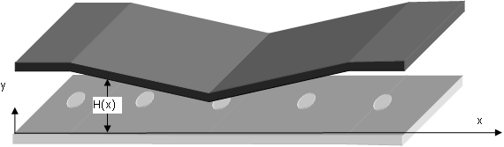
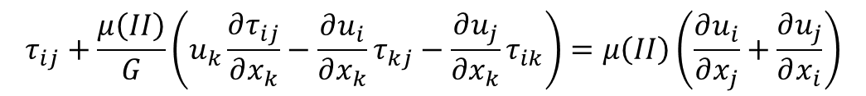
Diploma work J.Pavlovec: Výtlačný reometr pro viskoelastické kapaliny. 1991
Only INFO old presentation RZ8 (skip)
Adviser R.Žitný, oponent M.Houška
Convergent section with positive elongation
Divergent section compression of fibers
Constitutive model UCM (upper convective Maxwell) modification White-Metzner
$$τ_{ij}+\frac{μ\left(II\right)}{G}\left(u_{k}\frac{∂τ_{ij}}{∂x_{k}}−\frac{∂u_{i}}{∂x_{k}}τ_{kj}−\frac{∂u_{j}}{∂x_{k}}τ_{ik}\right)=μ\left(II\right)\left(\frac{∂u_{i}}{∂x_{j}}+\frac{∂u_{j}}{∂x_{i}}\right)$$
Relaxation time
Viscosity

Slide 7
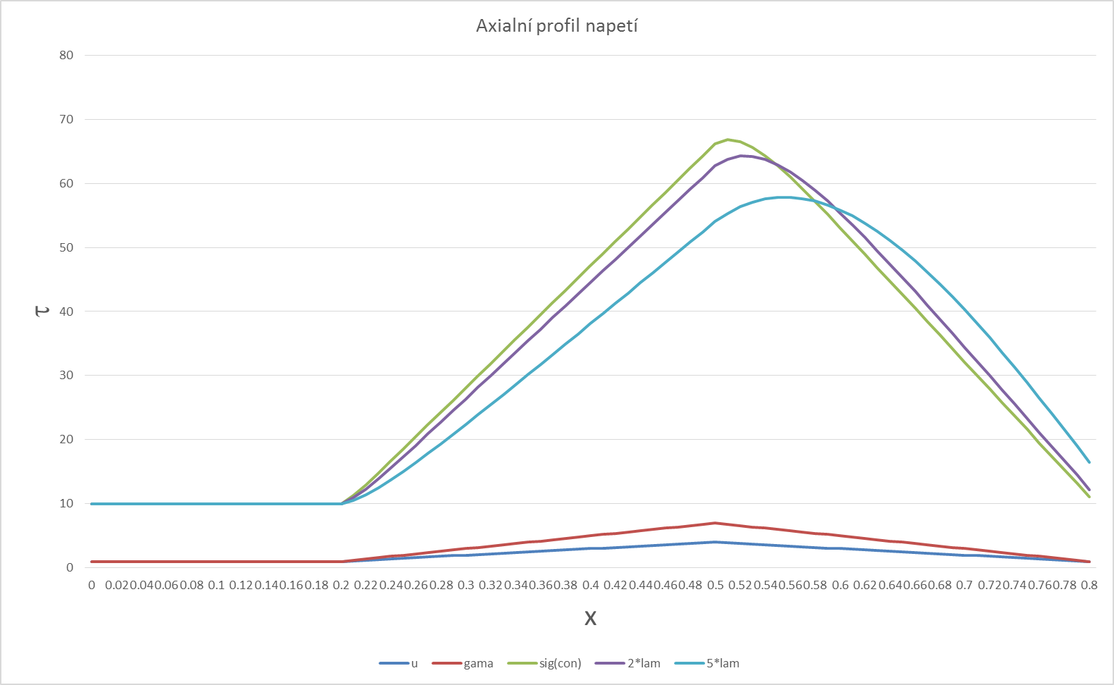
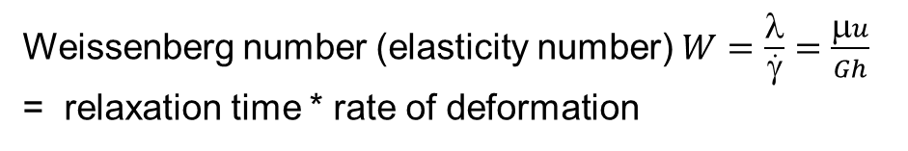



Vague idea of Maxwellian model (maxwell.xlsx)
Vague because it does not specify the nature of the stress τ (imagine that it is for example an elongation stress in the direction of flow). The model considers a linear change in velocity Δu and strain rate Δγ along a channel.
Only INFO old presentation RZ8 (skip)
$$τ+λ\left(u_{0}+Δu∙x\right)\frac{dτ}{dx}=μ\left(γ_{0}+Δγ∙x\right)$$
$$λ=\frac{μ}{G}$$
relaxation time [s]
Particular solution
$$τ_{P}=\frac{μ}{1+λ∆u}\left(γ_{0}+λ\left(γ_{0}Δu−u_{0}Δγ\right)+Δγx\right)$$
General solution
$$τ=\frac{μ}{1+λ∆u}\left(γ_{0}+λ\left(γ_{0}Δu−u_{0}Δγ\right)+Δγx\right)+c∙exp\left(−\frac{1}{λ∆u}ln⁡(x+\frac{u_{0}}{∆u})\right)$$
λ
5λ
Effect of relaxation time λ increase to axial stress profile τ (λ, 2λ, 5λ)
Weissenberg number (elasticity number) $W=\frac{λ}{\dot{γ}}=\frac{μu}{Gh}$ = relaxation time * rate of deformation

Slide 8
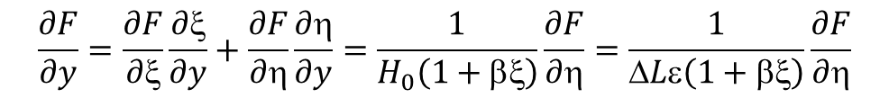
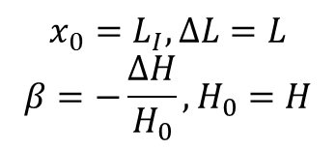
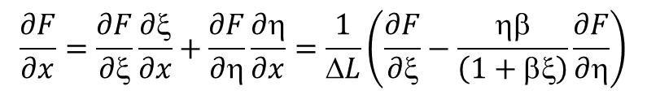
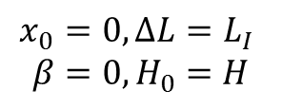

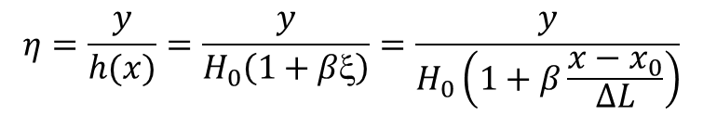
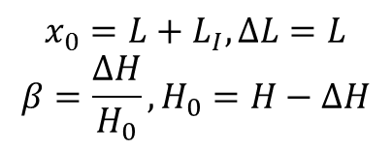
Pavlovec : dimensionless parameters
Kontroloval: Frouz
Kontroloval FROUZ
Only INFO old presentation RZ8 (skip)
Transformation into an orthogonal coordinate system
H
ΔH
L_{I}
L
L
L_{I}
L
L
x
$$=\frac{x−x_{0}}{∆L}$$
$$η=\frac{y}{h(x)}=\frac{y}{H_{0}\left(1+βξ\right)}=\frac{y}{H_{0}\left(1+β\frac{x−x_{0}}{∆L}\right)}$$
Inlet section Convergent section Divergent section
$$x_{0}=0, ∆L=L_{I}$$
$$β=0, H_{0}=H$$
$$x_{0}=L_{I}, ∆L=L$$
$$β=−\frac{∆H}{H_{0}}, H_{0}=H$$
$$x_{0}={L+L}_{I}, ∆L=L$$
$$β=\frac{∆H}{H_{0}}, H_{0}=H−∆H$$
Transformation of derivatives
$$\frac{∂F}{∂x}=\frac{∂F}{∂ξ}\frac{∂ξ}{∂x}+\frac{∂F}{∂η}\frac{∂η}{∂x}=\frac{1}{ΔL}\left(\frac{∂F}{∂ξ}−\frac{ηβ}{\left(1+βξ\right)}\frac{∂F}{∂η}\right)$$
$$\frac{∂F}{∂y}=\frac{∂F}{∂ξ}\frac{∂ξ}{∂y}+\frac{∂F}{∂η}\frac{∂η}{∂y}=\frac{1}{H_{0}\left(1+βξ\right)}\frac{∂F}{∂η}=\frac{1}{ΔLε\left(1+βξ\right)}\frac{∂F}{∂η}$$

Slide 9

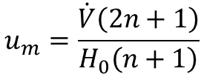





Power law approximation of velocities
Kontroloval FROUZ
Axial velocity
Only INFO old presentation RZ8 (skip)
$$u_{x}=\frac{u_{m}}{1+βξ}(1−{\left(1−2η\right)}^{\frac{n+1}{n}}), η<0.5$$
$$u_{x}=\frac{u_{m}}{1+βξ}\left(1−{\left(2η−1\right)}^{\frac{n+1}{n}}\right), η>0.5$$
$$u_{m}=\frac{\dot{V}\left(2n+1\right)}{H_{0}\left(n+1\right)}$$
$$\frac{∂u_{x}}{∂x}+\frac{∂u_{y}}{∂y}=0$$
Transversal component (satisfying continuity equation )
$$u_{y}=\frac{{εβu}_{m}}{1+βξ}η(1−{\left(1−2η\right)}^{\frac{n+1}{n}}), η<0.5$$
$$u_{y}=\frac{{εβu}_{m}}{1+βξ}η(1−{\left(2η−1\right)}^{\frac{n+1}{n}}), η>0.5$$
$$ε=\frac{H_{0}}{∆L}$$

Slide 10
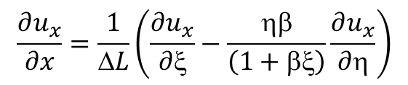
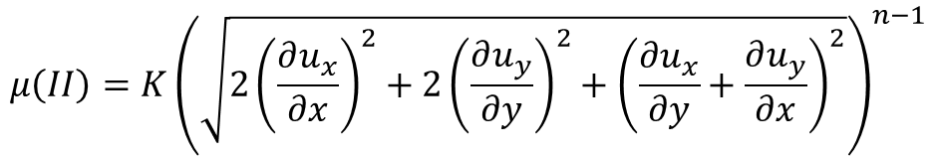
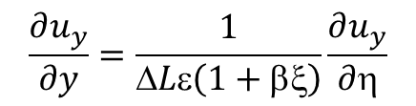
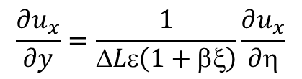
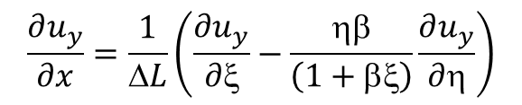
Power law approximation of viscosity
Kontroloval FROUZ
Only INFO old presentation RZ8 (skip)
Viscosity as a power function of the second invariant
$$μ\left(II\right)=K{\left(\sqrt{{2\left(\frac{∂u_{x}}{∂x}\right)}^{2}+2{\left(\frac{∂u_{y}}{∂y}\right)}^{2}+{\left(\frac{∂u_{x}}{∂y}+\frac{∂u_{y}}{∂x}\right)}^{2}}\right)}^{n−1}$$
Rate of deformation in the dimensionless coordinates ξ∈(0,1), η∈(0,1)
$$\frac{∂u_{x}}{∂x}=\frac{1}{ΔL}\left(\frac{∂u_{x}}{∂ξ}−\frac{ηβ}{\left(1+βξ\right)}\frac{∂u_{x}}{∂η}\right)$$
$$\frac{∂u_{x}}{∂y}=\frac{1}{ΔLε\left(1+βξ\right)}\frac{∂u_{x}}{∂η}$$
$$\frac{∂u_{y}}{∂x}=\frac{1}{ΔL}\left(\frac{∂u_{y}}{∂ξ}−\frac{ηβ}{\left(1+βξ\right)}\frac{∂u_{y}}{∂η}\right)$$
$$\frac{∂u_{y}}{∂y}=\frac{1}{ΔLε\left(1+βξ\right)}\frac{∂u_{y}}{∂η}$$

Slide 11



Constitutive equation White Metzner
Kontroloval FROUZ
Only INFO old presentation RZ8 (skip)
$$_{xx}=−p+_{xx}$$
An important conclusion: the lower flat plate is τ_{yy} = 0, which means that the pressure sensor measures the isotropic pressure p
$$_{yy}=−p+_{yy}$$
$$_{xy}=_{xy}$$
$$τ_{xx}+\frac{μ\left(II\right)}{G}\left(u_{x}\frac{∂τ_{xx}}{∂x}+u_{y}\frac{∂τ_{xx}}{∂y}−2\frac{∂u_{x}}{∂x}τ_{xx}−2\frac{∂u_{x}}{∂y}τ_{xy}\right)=2μ\left(II\right)\frac{∂u_{x}}{∂x}$$
$$τ_{yy}+\frac{μ\left(II\right)}{G}\left(u_{x}\frac{∂τ_{yy}}{∂x}+u_{y}\frac{∂τ_{yy}}{∂y}−2\frac{∂u_{y}}{∂x}τ_{xy}−2\frac{∂u_{y}}{∂y}τ_{yy}\right)=2μ\left(II\right)\frac{∂u_{y}}{∂y}$$
$$τ_{xy}+\frac{μ\left(II\right)}{G}\left(u_{x}\frac{∂τ_{xy}}{∂x}+u_{y}\frac{∂τ_{xy}}{∂y}−\frac{∂u_{y}}{∂x}τ_{xx}−\frac{∂u_{x}}{∂y}τ_{yy}\right)=μ\left(II\right)\left(\frac{∂u_{x}}{∂y}+\frac{∂u_{y}}{∂x}\right)$$

Slide 12
Pressure distribution by integration Cauchy equations from left. Results
Only INFO old presentation RZ8 (skip)
%main white-metzner
clear all;
K=100;
n=0.5;
nx=59;
ny=37;
dl=0.2;
h=0.005;
h0=h;
dh=0.004;
um=0.1;
vdot=um*h0*(n+1)/(2*n+1)
G=5000
beta=0;
uxy;
for i=1:nx
pp(i)=pav(i);
x(i)=(i-1)*dl/(nx-1);
end
beta=-dh/h0;
uxy;
ig=nx;
ig0=ig;
for i=2:nx
ig=ig+1;
pp(ig)=pav(i);
x(ig)=(ig-1)*dl/(nx-1);
end
ig1=ig;
h0=h-dh;
beta=dh/h0;
uxy;
for i=2:nx
ig=ig+1;
pp(ig)=pav(i);
x(ig)=(ig-1)*dl/(nx-1);
end
ig2=ig;
figure(1)
plot(x(1:ig2),pp(1:ig2))
hold on
plot(x(ig0),pp(ig0),'ro')
plot(x(ig1),pp(ig1),'ro')
plot(x(ig2),pp(ig2),'ro')
d1=pp(ig0)-pp(ig1);
d2=pp(ig1)-pp(ig2);
drel=(d1-d2)/max(abs(d1),abs(d2));
disp(sprintf('dp conv=%0.5g dp div=%0.5g dif=%0.5g',d1,d2,drel));
title(sprintf('G=%0.5g diff=%0.5g Vdot=%0.3g',G,drel,vdot))
xlabel('x [m]')
ylabel('p [Pa]')
% white metzner - velocities
% rychlosti ux(1:nx,1:ny),uy(1:nx,1:ny),
% derivace duxdksi(1:nx,1:ny), duxdeta(1:nx,1:ny), duydksi(1:nx,1:ny), duydeta(1:nx,1:ny)
% duxdx(1:nx,1:ny), duxdy(1:nx,1:ny), duydy(1:nx,1:ny), duydx(1:nx,1:ny)
% viskozity mju(1:nx,1:ny)
% beta, dl, h0, n, vdot, K G koeficient konzistence a modul G
Peek pressure on the axis of the channel is about an approximation error

Slide 13

$$W=\frac{Ku}{Gh}=\frac{2000}{G}$$
Axial pressure profiles p(x) (n=0.5, K=100, V=0.000375 m²/s)
Commented presentation RZ8
The graphs show what happens when you grow modulus G (resp. While reducing the relaxation time). Small values G represent great influence elasticity (pressure gradient in the convergent gap is then smaller than the divergent)
W=18
W=10
W=4
W=2
W=0.4
G = 5000 negligible elasticity, different pressures are error of approximation

Slide 14
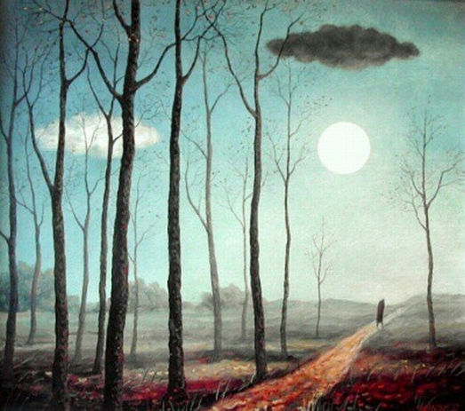

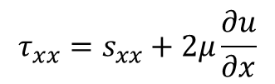


Stream function, vorticity, elastic stresses
ψ
$$u=\frac{∂ψ}{∂y}$$
$$v=−\frac{∂ψ}{∂x}$$
ω
$$=\frac{∂v}{∂x}−\frac{∂u}{∂y}$$
s
$$τ_{xx}=s_{xx}+2μ\frac{∂u}{∂x}$$

Slide 15
Stream function, vorticity, elastic stresses
Geometry
Approximate profiles u,v, ψ, ω for power law fluid
iteration
This is rather complicated project probably too difficult for batchelor or even diploma work.
However it can be significantly simplified by skiping the solution of flow ψ,ω (assuming only velocity approximation) and neglecting viscosity variation.
Elastic stresses sxx, syy, sxy (hyperbolic MW)
Poisson equation for ψ
Nodal velocities and viscosity. BC for ω
Poisson equation for ω
Poisson equation for pressure p

Slide 16





Gaussian axial profile of gap
The reason for choosing the smooth profile of the upper walls: the exclusion of the weak singularity at a sharp edge between converging and diverging axial channel crossection
y
Physical domain
Transformation of coordinates ξ(x,y) η(x,y)
and metric coefficients
necessary for transformation of first and second order derivatives
x
$$\frac{∂ξ}{∂x}$$
$$\frac{∂η}{∂x}$$
$$\frac{∂η}{∂y}$$
$$\frac{∂^{2}η}{∂x∂y}$$
$$\frac{∂^{2}η}{∂x2}$$
η
i,j+1
Computational domain
i,j
i,j-1
ξ

Slide 17
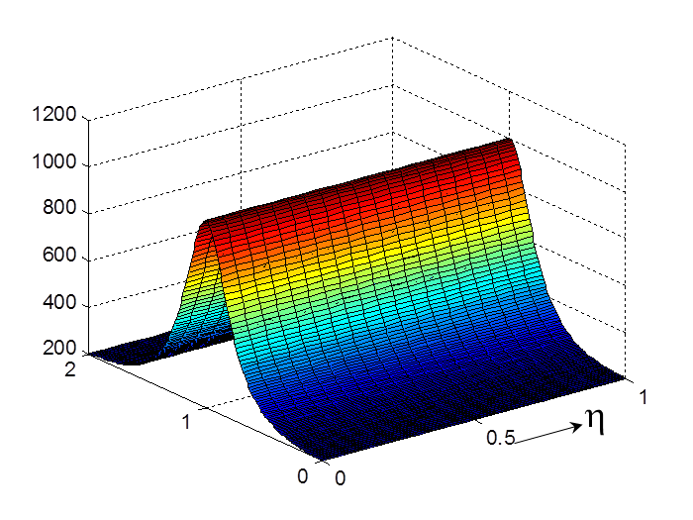
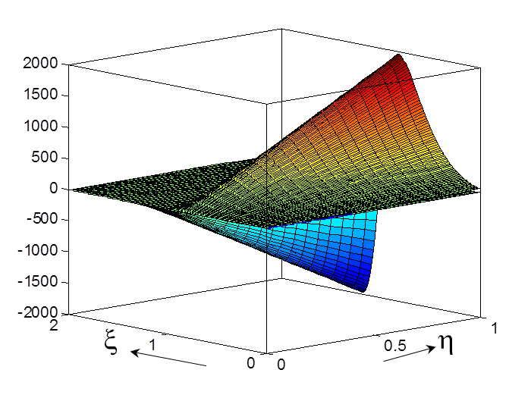












Gaussian axial profile of gap Metric coefficients of first derivatives
Kontroloval Zitny
Dimensionless geometric parameters
λ=$\frac{L_{k}}{δ}$
Λ=$\frac{L_{k}}{H}$
κ=$\frac{h}{H}$
λ=$\frac{L_{k}}{δ}$
$$E\left(ξ\right)=exp⁡(−λ^{2}{\left(1−ξ\right)}^{2})$$
H
y
$$\frac{∂η}{∂x}>0$$
η=1
$$\frac{∂η}{∂x}<0$$
Transformation from computational domain ξ(0,2) η(0,1) to physical domain x(0,L_{k}+L_{d}), y(0,H)
h
x
η=0
$$x=L_{k}$$
$$y=H(1−(1−)E)$$
L_{k}
L_{d}
$$\frac{∂ξ}{∂x}=\frac{1}{ L_{k}}$$
$$\frac{∂η}{∂x}=\frac{2Eλ^{2}η(1−ξ)(1−κ)}{(1−(1−κ)E) L_{k}}$$
$$\frac{∂η}{∂y}=\frac{1}{\left(1−(1−κ)E\right)H}$$
ξ

Slide 18
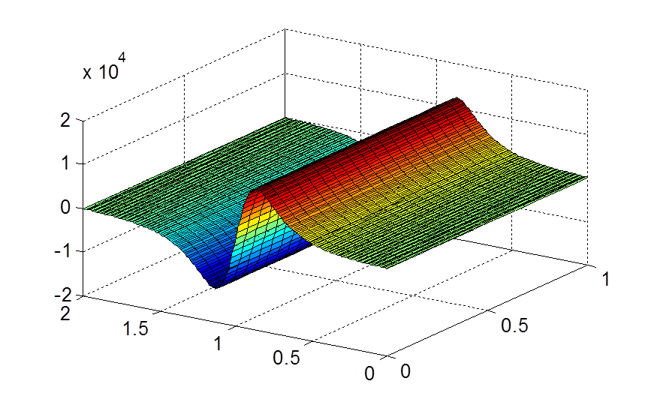
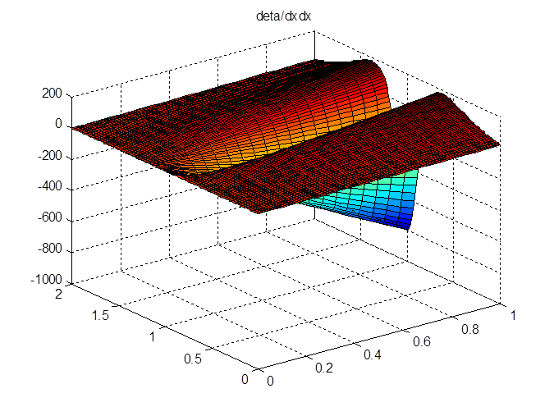
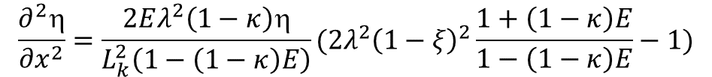

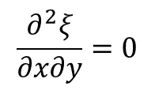
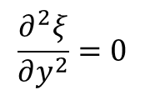

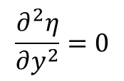
Gaussian axial profile of gap Metric coefficients of second derivatives
Kontroloval: zitny
$$\frac{∂^{2}ξ}{∂x^{2}}=0$$
$$\frac{∂^{2}ξ}{∂y^{2}}=0$$
$$\frac{∂^{2}ξ}{∂x∂y}=0$$
Because ξ depends upon x only linearly the second derivatives of ξ are zero
Only two derivatives of transversal coordinate η are nonzero
$$\frac{∂^{2}η}{∂y^{2}}=0$$
$$\frac{∂^{2}η}{∂x∂y}=\frac{2Eλ^{2}(1−ξ)(1−κ)}{\left(1−\left(1−κ\right)E\right)2 {HL}_{k}}$$
$$\frac{∂^{2}η}{∂x^{2}}=\frac{2Eλ^{2}\left(1−κ\right)η}{L_{k}^{2}\left(1−\left(1−κ\right)E\right)}(2λ^{2}{\left(1−ξ\right)}^{2}\frac{1+\left(1−κ\right)E}{1−\left(1−κ\right)E}−1)$$
Ověřeno numerickými diferencemi
ξ
η
η
ξ

Slide 19






INIT calculation of metric coefficients
INIT
geometry
Approximate profiles u,v, ψ, ω for power law fluid
Geometrie h, H, L_{k}, L_{d}, δ, N_{x}, _{Ny}
iteration
Elastic stress sxx, syy, sxy (hyperbolic MW)
ksi=linspace(0,2,nx);
eta=linspace(0,1,ny);
Poisson equation for ψ
Velocities, µ , BC for ω
i=1,2..N_{x}
Poisson equation for ω
J=1,2..N_{y}
Poisson equation for pressure p
$$yi,j=H(1−(1−)E)$$
$$xi=L_{k}$$
$$\frac{∂η}{∂x}|i,j=\frac{2Eλ^{2}η(1−ξ)(1−κ)}{(1−(1−κ)E) L_{k}}$$
$$\frac{∂η}{∂y}|i,j=\frac{1}{\left(1−(1−κ)E\right)H}$$
$$\frac{∂^{2}η}{∂x^{2}}|i,j=\frac{2Eλ^{2}\left(1−κ\right)η}{L_{k}^{2}\left(1−\left(1−κ\right)E\right)}(2λ^{2}{\left(1−ξ\right)}^{2}\frac{1+\left(1−κ\right)E}{1−\left(1−κ\right)E}−1)$$
$$\frac{∂^{2}η}{∂x∂y}|i,j=\frac{2Eλ^{2}(1−ξ)(1−κ)}{\left(1−\left(1−κ\right)E\right)2 L_{k}H}$$

Slide 20
INIT.m calculation of coefficients (MATLAB)
clearvars
um=0.1;n=0.5;K=100;
H=0.005;h=0.001;Lk=0.2;Ls=0.2;delta=0.1;
lambda=Lk/delta;
kappa=h/H;
nx=201;
ny=41;
ksi=linspace(0,2,nx);
eta=linspace(0,1,ny);
x=Lk*ksi;
for j=1:ny
for i=1:nx
E=exp(-(Lk/delta)^2*(ksi(i)-1)^2);
y(i,j)=eta(j)*H*(1-(1-kappa)*E);
end
end
%derivace transformaci
for i=1:nx
E=exp(-(lambda*(ksi(i)-1))^2);
for j=1:ny
k1=1-(1-kappa)*E;
dksidx(i,j)=1/Lk;
detadx(i,j)=eta(j)*(1-kappa)*E*2*lambda^2*(1-ksi(i))/(k1*Lk);
detady(i,j)=1/(k1*H);
detadxdy(i,j)=(1-kappa)*2*lambda^2*(1-ksi(i))*E/(H*Lk*k1^2);
detadxdx(i,j)=2*lambda^2*eta(j)*(1-kappa)*E/(Lk^2*k1)*(2*lambda^2*(1-ksi(i))^2*(1+(1-kappa)*E)/k1-1);
gxx(i,j)=dksidx(i,j)^2; gyy(i,j)=detadx(i,j)^2+detady(i,j)^2; gxy(i,j)=2*detadx(i,j)*dksidx(i,j); gx(i,j)=detadxdx(i,j);
end
end
%figure(2)
%surf(eta,ksi,detadx)
%title('deta/dx')
Matrices defined at INIT
x(nx), y(nx,ny) kartézské souřadnice
ksi(nx),eta(ny) výpočtová doména
dksidx(nx,ny),detadx(nx,ny),detady(nx,ny) ∂ξ/∂x, ∂η/∂x,
detadxdy(nx,ny),detadxdx(nx,ny) ∂²η/∂x∂y, ∂²η/∂x²,
gxx(nx,ny),…gx(nx,ny)
Matrices defined later
psi(nx,ny), omega(nx,ny)
u(nx,ny),v(nx,ny),dudx(nx,ny),dudy(nx,ny),dvdx(nx,ny),dvdy(nx,by)
mju(nx,ny),dmjudx(nx,ny), dmjudy(nx,ny), dmjudxdy(nx,ny), μ, ∂μ/∂x, ∂μ/∂y,
Approximation for power law fluid
psin(nx,ny), omegan(nx,ny)
un(nx,ny),vn(nx,ny),dudxn(nx,ny),dudyn(nx,ny),dvdxn(nx,ny),dvdyn(nx,by)
mjun(nx,ny),dmjudxn(nx,ny), dmjudyn(nx,ny), dmjudxdyn(nx,ny),
Stresses
sxx(nx,ny), syy(nx,ny), sxy(nx,ny),
geometry
Approximate profiles u,v, ψ, ω for power law fluid
iteration
Elastic stress sxx, syy, sxy (hyperbolic MW)
Poisson equation for ψ
Velocities, µ , BC for ω
Poisson equation for ω
Poisson equation for pressure p

Slide 21
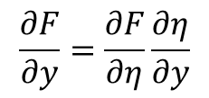
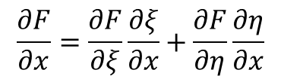
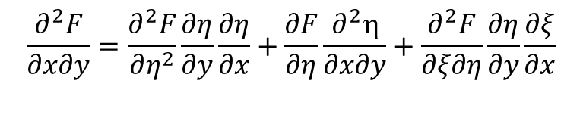
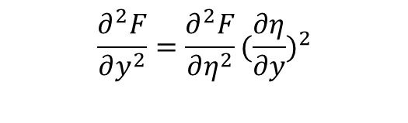
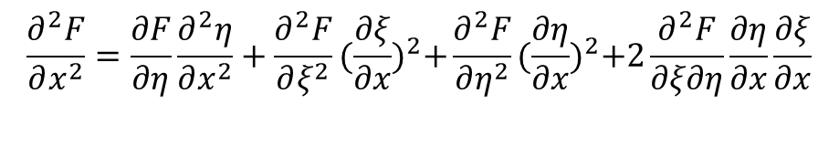
Transformation of derivatives of quantity F (e.g. ω, ψ, s_{xx}, s_{yy}, s_{xy})
Kontroloval: zitny
Transformation of first derivative
$$\frac{∂F}{∂x}=\frac{∂F}{∂ξ}\frac{∂ξ}{∂x}+\frac{∂F}{∂η}\frac{∂η}{∂x}$$
$$\frac{∂F}{∂y}=\frac{∂F}{∂η}\frac{∂η}{∂y}$$
Transformation of second derivatives (derivation is a bit lengthy)
$$\frac{∂^{2}F}{∂x^{2}}=\frac{∂F}{∂η}\frac{∂^{2}η}{∂x^{2}}+\frac{∂^{2}F}{∂ξ^{2}}{(\frac{∂ξ}{∂x})}^{2}+\frac{∂^{2}F}{∂η^{2}}{(\frac{∂η}{∂x})}^{2}+2\frac{∂^{2}F}{∂ξ∂η}\frac{∂η}{∂x}\frac{∂ξ}{∂x}$$
$$\frac{∂^{2}F}{∂y^{2}}=\frac{∂^{2}F}{∂η^{2}}{(\frac{∂η}{∂y})}^{2}$$
$$\frac{∂^{2}F}{∂x∂y}=\frac{∂^{2}F}{∂η^{2}}\frac{∂η}{∂y}\frac{∂η}{∂x}+\frac{∂F}{∂η}\frac{∂^{2}η}{∂x∂y}+\frac{∂^{2}F}{∂ξ∂η}\frac{∂η}{∂y}\frac{∂ξ}{∂x}$$
$$\frac{∂^{2}F}{∂x∂y}=\frac{∂}{∂x}\frac{∂F}{∂η}\frac{∂η}{∂y}=\frac{∂^{2}F}{∂x∂}\frac{∂η}{∂y}+\frac{∂F}{∂η}\frac{∂^{2}}{∂x∂y}=(\frac{∂^{2}F}{∂ξ∂}\frac{∂ξ}{∂x}+\frac{∂^{2}F}{∂2}\frac{∂}{∂x})\frac{∂η}{∂y}+\frac{∂F}{∂η}\frac{∂^{2}}{∂x∂y}$$
... it would be possible to express the transformation of derivatives also in the reverse direction, but usually we do not need this

Slide 22

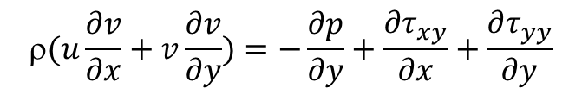
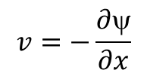
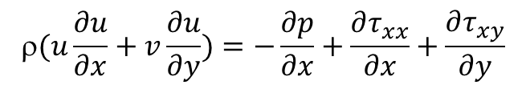
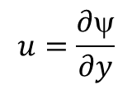
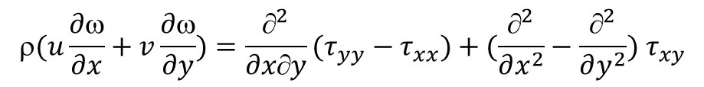

Cauchy equations with consideration of inertia forces
Kontroloval: zitny
$$(u\frac{∂u}{∂x}+v\frac{∂u}{∂y})=−\frac{∂p}{∂x}+\frac{∂τ_{xx}}{∂x}+\frac{∂τ_{xy}}{∂y}$$
$$(u\frac{∂v}{∂x}+v\frac{∂v}{∂y})=−\frac{∂p}{∂y}+\frac{∂τ_{xy}}{∂x}+\frac{∂τ_{yy}}{∂y}$$
$$=\frac{∂v}{∂x}−\frac{∂u}{∂y}$$
Elimination of pressure by introducing the vorticity and using the continuity equation
The result is the transport equation of vorticity (right side resultant stress). At zero Re (creeping flow, ρ≅0) the left side is zero and vorticity disappears from this equation.
$$(u\frac{∂ω}{∂x}+v\frac{∂ω}{∂y})=\frac{∂^{2}}{∂x∂y}(τ_{yy}−τ_{xx})+(\frac{∂^{2}}{∂x^{2}}−\frac{∂^{2}}{∂y^{2}}) τ_{xy}$$
$$u=\frac{∂ψ}{∂y}$$
$$v=−\frac{∂ψ}{∂x}$$
Fulfill the continuity equation by introducing the current function
$$−ω=\frac{∂^{2}ψ}{∂x^{2}}+\frac{∂^{2}ψ}{∂y^{2}}$$

Slide 23
Initial conditions - stream function (for a power law fluid)
geometry
Stream function ψ(ξ,η)
Approximate profiles u,v, ψ, ω for power law fluid
iteration
Elastic stress sxx, syy, sxy (hyperbolic MW)
Poisson equation for ψ
Velocities, µ , BC for ω
Poisson equation for ω
Velocity components u,v (ξ,η)
Poisson equation for pressure p
Velocities calculated in this way satisfy continuity equation and correspond to the steady creeping flow of power law fluid (without elastic effects). It is assumed that these initial conditions can be applied also as boundary conditions at inlet and outlet (far from the disturbance of throat).

Slide 24
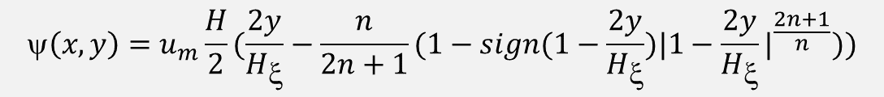
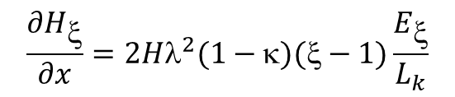
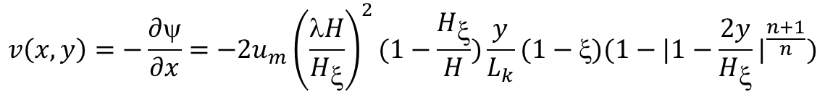
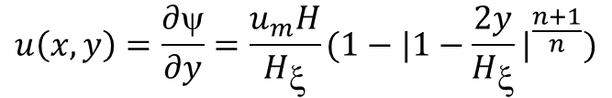
Initial conditions - stream function (for a power law fluid)
Kontroloval: zitny
Section corresponding to the distance from the entrance ξ=x/L_{k}
$$Hξ=H\left(1−\left(1−κ\right)e^{−λ^{2}\left(1−ξ\right)2}\right)=H(1−\left(1−κ\right)Eξ)$$
$$\frac{∂H_{ξ}}{∂x}=2Hλ^{2}(1−κ)(ξ−1)\frac{E_{ξ}}{L_{k}}$$
Stream function (u_{m} is maximum velocity for the gap thickness H). It holds u_{m}H=u_{mξ}H_{ξ} .
$$\left(x,y\right)=u_{m}\frac{H}{2}(\frac{2y}{H_{ξ}}−\frac{n}{2n+1}(1−sign(1−\frac{2y}{H_{ξ}}){|1−\frac{2y}{H_{ξ}}|}^{\frac{2n+1}{n}}))$$
$$\left(η\right)=u_{m}\frac{H}{2}(2η−\frac{n}{2n+1}(1−sign(1−2η){|1−2η|}^{\frac{2n+1}{n}}))$$
Corresponding velocity components
$$u\left(x,y\right)=\frac{∂ψ}{∂y}=\frac{u_{m}H}{H_{ξ}}(1−{|1−\frac{2y}{H_{ξ}}|}^{\frac{n+1}{n}})$$
$$v\left(x,y\right)=−\frac{∂ψ}{∂x}=−2u_{m}{\left(\frac{λH}{H_{ξ}}\right)}^{2}(1−\frac{H_{ξ}}{H})\frac{y}{L_{k}}(1−ξ)(1−{|1−\frac{2y}{H_{ξ}}|}^{\frac{n+1}{n}})$$

Slide 25
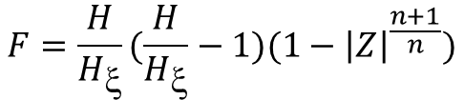

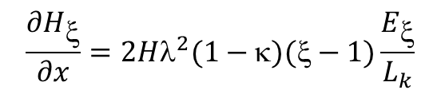



Initial conditions – vorticity (for a power law fluid)
Kontroloval: zitny
$$=\frac{∂v}{∂x}−\frac{∂u}{∂y}$$
corresponds to the direction anti-clockwise
Vorticity
$$Hξ=H\left(1−\left(1−κ\right)e^{−λ^{2}\left(1−ξ\right)2}\right)=H(1−\left(1−κ\right)Eξ)$$
$$Z=1−\frac{2y}{H_{ξ}}$$
$$\frac{∂H_{ξ}}{∂x}=2Hλ^{2}(1−κ)(ξ−1)\frac{E_{ξ}}{L_{k}}$$
Auxilliary variables
$$F=\frac{H}{H_{ξ}}(\frac{H}{H_{ξ}}−1)(1−{\left|Z\right|}^{\frac{n+1}{n}})$$
$$\frac{∂F}{∂H_{ξ}}=\frac{H}{H_{ξ}^{2}}((1−2\frac{H}{H_{ξ}})(1−{\left|Z\right|}^{\frac{n+1}{n}}) −sign\left(Z\right)(\frac{H}{H_{ξ}}−1)\frac{n+1}{n}{\left|Z\right|}^{\frac{1}{n}}\left(1−Z\right))$$
$$\frac{∂u}{∂y}=\frac{∂^{2}ψ}{∂y^{2}}=\frac{2u_{m}H}{H_{ξ}2}(\frac{n+1}{n})sign(Z){|Z|}^{\frac{1}{n}}$$
$$\frac{∂v}{∂x}=−\frac{∂^{2}ψ}{∂x^{2}}=−\frac{2u_{m}λ^{2}y}{L_{k}}(\frac{∂F}{∂H_{ξ}}\frac{∂H_{ξ}}{∂x}\left(1−ξ\right)−\frac{K}{L_{k}})$$
Verified by three methods: analytically, direct numerical difference and differential transformed derivatives (it took me few days to match the threee procedures

Slide 26







Initial conditions – viscosity (for a power law fluid)
Kontroloval: zitny
$$Z=1−\frac{2y}{H_{ξ}}$$
$$Hξ=H\left(1−\left(1−κ\right)e^{−λ^{2}\left(1−ξ\right)2}\right)=H(1−\left(1−κ\right)Eξ)$$
Auxilliary variables
$$\frac{∂u}{∂x}=\frac{∂2ψ}{∂x∂y}=−2u_{m}{\left(\frac{Hλ}{H_{ξ}}\right)}^{2}(1−κ)E_{ξ}\frac{ξ−1}{L_{k}}(1−{\left|Z\right|}^{\frac{n+1}{n}}+\left(\frac{n+1}{n}\right)sign\left(Z\right){\left|Z\right|}^{\frac{1}{n}}\left(1−Z\right))$$
Verified numerically
$$\frac{∂v}{∂y}=−\frac{∂2ψ}{∂x∂y}=−2u_{m}{\left(\frac{Hλ}{H_{ξ}}\right)}^{2}(1−\frac{H_{ξ}}{H}) \frac{1−ξ}{L_{k}}(1−{\left|Z\right|}^{\frac{n+1}{n}}+\left(\frac{n+1}{n}\right)sign\left(Z\right){\left|Z\right|}^{\frac{1}{n}}\left(1−Z\right))$$
$$μ\left(II\right)=K{\left(\sqrt{{2\left(\frac{∂u}{∂x}\right)}^{2}+2{\left(\frac{∂v}{∂y}\right)}^{2}+{\left(\frac{∂u}{∂y}+\frac{∂v}{∂x}\right)}^{2}}\right)}^{n−1}$$
Dangerous peeks correspond to regions with smal velocity gradients (this is disadvantage of power law model)
Analytical expressions for first derivatives are too complicated and will be approximated numerically
$$\frac{∂µ}{∂x}=\frac{∂µ}{∂ξ}\frac{∂ξ}{∂x}+\frac{∂µ}{∂η}\frac{∂η}{∂x}≅\frac{µ_{E}−µ_{W}}{2h_{x}}\frac{∂ξ}{∂x}+\frac{µ_{N}−µ_{S}}{2h_{y}}\frac{∂η}{∂x}$$
$$\frac{∂µ}{∂y}=\frac{∂µ}{∂η}\frac{∂η}{∂y}≅\frac{µ_{N}−µ_{S}}{2h_{y}}\frac{∂η}{∂y}$$

Slide 27
Initial conditions – POWER.m (MATLAB code 1/2)
geometry
Approximate profiles u,v, ψ, ω for power law fluid
Velocities, stream function, vorticity, viscosity for power law fluids
iteration
Elastic stress sxx, syy, sxy (hyperbolic MW)
for i=1:nx
Ek=exp(-lambda^2*(1-ksi(i))^2);
Hk=H*(1-(1-kappa)*Ek);
for j=1:ny
Z=1-2*y(i,j)/Hk;
HK=H/Hk;
psi(i,j)=um*H/2*(1-Z-n/(2*n+1)*(1-sign(Z)*abs(Z)^((2*n+1)/n)));
u(i,j)=um*H/Hk*(1-abs(Z)^((n+1)/n));
v(i,j)=-2*um*(lambda*H/Hk)^2*(1-Hk/H)*(1-ksi(i))*y(i,j)/Lk*(1-abs(Z)^((n+1)/n));
dudy(i,j)=2*um*H/Hk^2*(n+1)/n*sign(Z)*abs(Z)^(1/n);
F=(HK^2-HK)*(1-abs(Z)^((n+1)/n));
dHkdx=2*H*lambda^2*(1-kappa)*(ksi(i)-1)*Ek/Lk;
dFdHk=H/Hk^2*((-2*HK+1)*(1-abs(Z)^((n+1)/n))-sign(Z)*(HK-1)*(n+1)/n*abs(Z)^(1/n)*(1-Z));
dvdx(i,j)=-2*um*lambda^2*y(i,j)/Lk*(dFdHk*dHkdx*(1-ksi(i))-F/Lk);
omega(i,j)=dvdx(i,j)-dudy(i,j);
dudx(i,j)=-2*um*(HK*lambda)^2*(1-kappa)*(ksi(i)-1)*Ek/Lk*(1-abs(Z)^((n+1)/n)+sign(Z)*(n+1)/n*abs(Z)^(1/n)*(1-Z));
dvdy(i,j)=-2*um*(HK*lambda)^2*(1-1/HK)*(1-ksi(i))/Lk*(1-abs(Z)^((n+1)/n)+sign(Z)*(n+1)/n*abs(Z)^(1/n)*(1-Z));
mju(i,j)=K*(2*dudx(i,j)^2+2*dvdy(i,j)^2+(dudy(i,j)+dvdx(i,j))^2)^((n-1)/2);
end
end
Poisson equation for ψ
Velocities, µ , BC for ω
Poisson equation for ω
Poisson equation for pressure p

Slide 28
Initial conditions – POWER.m (MATLAB code 2/2)
geometry
Approximate profiles u,v, ψ, ω for power law fluid
Approximation of viscosity derivatives
iteration
Elastic stress sxx, syy, sxy (hyperbolic MW)
dmjudx(1:nx,1:ny)=0; dmjudy(1:nx,1:ny)=0;
for i=2:nx-1
for j=2:ny-1
dmjudx(i,j)=(mju(i+1,j)-mju(i-1,j))/(2*hx)*dksidx(i,j)+(mju(i,j+1)-mju(i,j-1))/(2*hy)*detadx(i,j);
dmjudy(i,j)=(mju(i,j+1)-mju(i,j-1))/(2*hy)*detady(i,j);
end
end
for i=1:nx
dmjudx(i,1)=dmjudx(i,2);
dmjudx(i,ny)=dmjudx(i,ny-1);
end
for j=1:ny
dmjudx(1,j)=dmjudx(2,j);
dmjudx(nx,j)=dmjudx(nx-1,j);
end
% copy matrices
psin=psi; omegan=omega; un=u; vn=v;
dudxn=dudx; dudyn=dudy; dvdxn=dvdx; dvdyn=dvdy;
mjun=mju; dmjudxn=dmjudx(nx,ny); dmjudyn=dmjudy;
Poisson equation for ψ
Velocities, µ , BC for ω
Poisson equation for ω
Poisson equation for pressure p

Slide 29







PSI Transformation of stream function into computational domain
Kontroloval: zitny
Poisson equation for stream function can be transformed into computational domain using previously calculated metric coefficients
$$\frac{∂^{2}ψ}{∂x^{2}}+\frac{∂^{2}ψ}{∂y^{2}}=−ω$$
$$\frac{∂^{2}ψ}{∂ξ^{2}}{(\frac{∂ξ}{∂x})}^{2} +\frac{∂^{2}ψ}{∂^{2}}\left({\left(\frac{∂}{∂x}\right)}^{2}+{\left(\frac{∂}{∂y}\right)}^{2}\right)+2\frac{∂^{2}ψ}{∂ξ∂}\frac{∂}{∂x}\frac{∂ξ}{∂x}+\frac{∂ψ}{∂}\frac{∂^{2}}{∂x^{2}}=−ω$$
$$\frac{∂^{2}ψ}{∂ξ^{2}}g_{xx} +\frac{∂^{2}ψ}{∂η^{2}}g_{yy}+\frac{∂^{2}ψ}{∂ξ∂η}g_{xy}+\frac{∂ψ}{∂η}g_{x}=−ω$$
$$gxx={(\frac{∂ξ}{∂x})}^{2}$$
$$gyy={\left(\frac{∂η}{∂x}\right)}^{2}+{\left(\frac{∂η}{∂y}\right)}^{2}$$
$$gxy=2\frac{∂η}{∂x}\frac{∂ξ}{∂x}$$
$$gx=\frac{∂^{2}η}{∂x^{2}}$$

Slide 30


PSI Discretization of stream function
Kontroloval: xxxxxx
η
η=1
i,j+1
i,j
h_{y}
i,j-1
ξ
η=0
ξ=0
ξ=1
ξ=2
h_{x}
$$\frac{∂^{2}ψ}{∂ξ^{2}}g_{xx} +\frac{∂^{2}ψ}{∂η^{2}}g_{yy}+\frac{∂^{2}ψ}{∂ξ∂η}g_{xy}+\frac{∂ψ}{∂η}g_{x}=−ω$$
$$\frac{g_{xx}}{h_{x}^{2}}\left(_{i−1,j}−2_{i,j}+_{i+1,j}\right)+\frac{g_{yy}}{h_{y}^{2}}\left(_{i,j−1}−2_{i,j}+_{i,j+1}\right)+\frac{g_{xy}}{{4h}_{x}h_{y}}\left(_{i+1,j+1}+_{i−1,j−1}−_{i−1,j+1}−_{i+1,j−1}\right)+\frac{g_{x}}{2h_{y}}\left(_{i,j+1}−_{i,j−1}\right)=−ω_{ij}$$

Slide 31
PSI by alternation direction implicit method (ADI) Time evolution approximation
geometry
PSI
Approximate profiles u,v, ψ, ω for power law fluid
This horizontal sweep doesn’t work correctly. Maybe because ψ is almost independent on ξ
iteration
iter=1,2,…
Elastic stress sxx, syy, sxy (hyperbolic MW)
i=2..N_{x}-1
Poisson equation for ψ
Sweep of tridiagonal system for ψ in horizontal direction (only smoothing)
Velocities, µ , BC for ω
Poisson equation for ω
Poisson equation for pressure p
i=2..N_{x}-1
Sweep of tridiagonal system for ψ in vertical direction (sections ξ_{i})
Norm of difference ψ_{new}-ψ_{old} and repetition the PSI loop

Slide 32








PSI Discretization of stream function (time marching)
Kontroloval: xxxxxx
$$gxx={(\frac{∂ξ}{∂x})}^{2}$$
$$gyy={\left(\frac{∂η}{∂x}\right)}^{2}+{\left(\frac{∂η}{∂y}\right)}^{2}$$
$$gxy=2\frac{∂η}{∂x}\frac{∂ξ}{∂x}$$
$$gx=\frac{∂^{2}η}{∂x^{2}}$$
g_{xx} … coefficients were calculated during INIT.m
$$\frac{ψ^{1}−ψ}{Δt1}=ω+\frac{∂^{2}ψ1}{∂x^{2}}+\frac{∂^{2}ψ}{∂y^{2}}$$
$$\frac{ψ^{2}−ψ^{1}}{Δt2}=ω+\frac{∂^{2}ψ1}{∂x^{2}}+\frac{∂^{2}ψ2}{∂y^{2}}$$
This part (ξ-implicit step) does not work at tests
ξ-implicit (horizontal lines)
It was substituted by a simple filter, see the source code
$${\frac{_{ij}^{1}}{{Δt}_{1}}−1}_{i−1,j}\left(\frac{g_{xx}}{h_{x}^{2}}\right)+2\frac{g_{xx}}{h_{x}^{2}}{1}_{i,j}−{1}_{i+1,j}\left(\frac{g_{xx}}{h_{x}^{2}}\right)=\frac{_{ij}^{}}{{Δt}_{1}}+\frac{g_{yy}}{h_{y}^{2}}\left(_{i,j−1}−2_{i,j}+_{i,j+1}\right)$$
$$+\frac{g_{xy}}{{4h}_{x}h_{y}}\left(_{i+1,j+1}+_{i−1,j−1}−_{i−1,j+1}−_{i+1,j−1}\right)+\frac{g_{x}}{2h_{y}}\left(_{i,j+1}−_{i,j−1}\right)+ω_{ij}$$
η-implicit (vertical lines)
$${\frac{_{ij}^{2}}{{Δt}_{2}}−2}_{i,j−1}\left(\frac{g_{yy}}{h_{y}^{2}}−\frac{g_{x}}{2h_{y}}\right)+2\frac{g_{yy}}{h_{y}^{2}}{2}_{i,j}−\left(\frac{g_{yy}}{h_{y}^{2}}+\frac{g_{x}}{2h_{y}}\right){2}_{i,j+1}=\frac{_{ij}^{1}}{{Δt}_{2}}+\frac{g_{xx}}{h_{x}^{2}}\left({1}_{i−1,j}−2{1}_{i,j}+{1}_{i+1,j}\right) +\frac{g_{xy}}{{4h}_{x}h_{y}}\left({1}_{i+1,j+1}+_{i−1,j−1}−_{i−1,j+1}−_{i+1,j−1}\right)+ω_{ij}$$

Slide 33
PSI Discretization of stream function PSIE.m (MATLAB)
Kontroloval: xxxxxx
Estimated time step
dt2=(H/ny)^2*1e3; dt1=(Lk/nx)^2*1e3;
psiold=psi;
for iter=1:20
% horizontal lines (only smoothing)
for j=2:ny-1
aa(1)=0;bb(1)=1;cc(1)=0;dd(1)=psi(1,j); aa(nx)=0;bb(nx)=1;cc(nx)=0;dd(nx)=psi(nx,j);
for i=2:nx-1
aa(i)=-gxx(i,j)/hx^2; bb(i)=1/dt1+2*gxx(i,j)/hx^2; cc(i)=-gxx(i,j)/hx^2; dd(i)=psi(i,j)/dt1;
end
psi(1:nx,j)=tridag(aa,bb,cc,dd,nx);
end
% vertical lines
for i=2:nx-1
aa(1)=0;bb(1)=1;cc(1)=0;dd(1)=psi(i,1); aa(ny)=0;bb(ny)=1;cc(ny)=0;dd(ny)=psi(i,ny);
for j=2:ny-1
aa(j)=-gyy(i,j)/hy^2+gx(i,j)/(2*hy); bb(j)=1/dt2+2*gyy(i,j)/hy^2; cc(j)=-gyy(i,j)/hy^2-gx(i,j)/(2*hy);
ddxx=gxx(i,j)/hx^2*(psi(i-1,j)-2*psi(i,j)+psi(i+1,j)); ddxy=gxy(i,j)/(4*hx*hy)*(psi(i+1,j+1)+psi(i-1,j-1)-psi(i-1,j+1)-psi(i+1,j-1)); ddomega=omega(i,j);
dd(j)=psi(i,j)/dt2+ddxx+ddxy+ddomega;
end
psi(i,:)=tridag(aa,bb,cc,dd,ny);
end
% norm of differences
sum=0;
for i=1:nx
for j=1:ny
sum=sum+abs(psi(i,j)-psiold(i,j));
end
end
sdev=sum/(nx*ny)/psiw;
disp(sprintf(' iter=%d relsum=%.5g',iter,sdev))
if sdev<0.00001
break
end
end
function u = tridag(a,b,c,r,n)
bet=b(1);
u(1)=r(1)/bet;
for j=2:n
gam(j)=c(j-1)/bet;
bet=b(j)-a(j)*gam(j);
u(j)=(r(j)-a(j)*u(j-1))/bet;
end
for j=n-1:-1:1
u(j)=u(j)-gam(j+1)*u(j+1);
end
Soution of tridiagonal system by factorization

Slide 34
Post processing (velocities, viscosities, BC for vorticity) UVMBC.m
for i=2:nx-1
for j=2:ny-1
v(i,j)=-(psi(i+1,j)-psi(i-1,j))/(2*hx)*dksidx(i,j)-(psi(i,j+1)-psi(i,j-1))/(2*hy)*detadx(i,j);
u(i,j)=(psi(i,j+1)-psi(i,j-1))/(2*hy)*detady(i,j);
end
end
for i=2:nx-1
for j=2:ny-1
dudx(i,j)=(u(i+1,j)-u(i-1,j))/(2*hx)*dksidx(i,j)+(u(i,j+1)-u(i,j-1))/(2*hy)*detadx(i,j); dudy(i,j)=(u(i,j+1)-u(i,j-1))/(2*hy)*detady(i,j);
dvdx(i,j)=(v(i+1,j)-v(i-1,j))/(2*hx)*dksidx(i,j)+(v(i,j+1)-v(i,j-1))/(2*hy)*detadx(i,j); dvdy(i,j)=(v(i,j+1)-v(i,j-1))/(2*hy)*detady(i,j);
end
end
for i=2:nx-1
for j=2:ny-1
mju(i,j)=K*(2*dudx(i,j)^2+2*dvdy(i,j)^2+(dudy(i,j)+dvdx(i,j))^2)^((n-1)/2);
end
end
for i=2:nx-1
for j=2:ny-1
dmjudx(i,j)=(mju(i+1,j)-mju(i-1,j))/(2*hx)*dksidx(i,j)+(mju(i,j+1)-mju(i,j-1))/(2*hy)*detadx(i,j); dmjudy(i,j)=(mju(i,j+1)-mju(i,j-1))/(2*hy)*detady(i,j);
end
end
for i=1:nx
dmjudx(i,1)=dmjudx(i,2); dmjudx(i,ny)=dmjudx(i,ny-1);
end
for j=1:ny
dmjudx(1,j)=dmjudx(2,j); dmjudx(nx,j)=dmjudx(nx-1,j);
end
rlx=0.5;
for i=1:nx
omega(i,1)=omega(i,1)*(1-rlx)+rlx*2*psi(i,2)/hy^2*detady(i,1)^2;
omega(i,ny)=omega(i,ny)*(1-rlx)+rlx*2*(psi(i,ny-1)-psiw)/hy^2*(detadx(i,ny)^2+detady(i,ny)^2;
end
geometry
Approximate profiles u,v, ψ, ω for power law fluid
iteration
Elastic stress sxx, syy, sxy (hyperbolic MW)
Poisson equation for ψ
Velocities, µ , BC for ω
Poisson equation for ω
Poisson equation for pressure p

Slide 35



Decomposition extrastress on the elastic and viscous component
Kontroloval: zitny
Decomposition viscous stress tensor for purely viscous component (described by model GNF - Generalised Newtonian Fluid) and the elastic component s_{ij} is apparently purposeless, but has the advantage that it leads to an equation in which the vorticity ω dominates even at zero Re.
$$τ_{xx}=s_{xx}+2μ\frac{∂u}{∂x}$$
$$τ_{yy}=s_{yy}+2μ\frac{∂v}{∂y}=s_{yy}−2μ\frac{∂u}{∂x}$$
It is only an approximation of the corresponding constant viscosity
$$τ_{xy}=s_{xy}+μ(\frac{∂u}{∂y}+\frac{∂v}{∂x})$$
Transport equations for vorticity (right side of the resultant elastic strain). From a purely hyperbolic transport equation is zero Re turned out nice for elliptic equations ω (LAD - LAplacian Driven)
$$\left(u\frac{∂ω}{∂x}+v\frac{∂ω}{∂y}\right)−µ\left(\frac{^{2}ω}{∂x^{2}}+\frac{^{2}ω}{∂y^{2}}\right)=\frac{^{2}}{∂xy}\left(s_{yy}−s_{xx}\right)+\left(\frac{^{2}}{∂x^{2}}−\frac{^{2}}{∂y^{2}}\right)s_{xy}$$
For comparison
$$\left(u\frac{∂ω}{∂x}+v\frac{∂ω}{∂y}\right) =\frac{∂^{2}}{∂x∂y}(τ_{yy}−τ_{xx})+(\frac{∂^{2}}{∂x^{2}}−\frac{∂^{2}}{∂y^{2}}) τ_{xy}$$

Slide 36

Decomposition extrastress on the elastic and viscous component (variable µ9
Kontroloval: zitny
The variable viscosity (non-zero first and second derivatives of viscosity). In addition Laplacian vorticity there appears a number of terms (partial derivatives of velocity)
$$\frac{^{2}}{∂xy}\left(τ_{yy}−τ_{xx}\right)+\left(\frac{^{2}}{∂x^{2}}−\frac{^{2}}{∂y^{2}}\right)τ_{xy}=\frac{^{2}}{∂xy}\left(s_{yy}−s_{xx}\right)+\left(\frac{^{2}}{∂x^{2}}−\frac{^{2}}{∂y^{2}}\right)s_{xy}+μ\left(\frac{^{2}ω}{∂x^{2}}+\frac{^{2}ω}{∂y^{2}}\right)$$
$$+2\frac{∂}{∂x}\frac{∂ω}{∂x}+2\frac{∂}{∂y}\frac{∂ω}{∂y}+4\frac{∂^{2}}{∂x∂y}\frac{∂v}{∂y}+\left(\frac{∂^{2}}{∂x^{2}}−\frac{∂^{2}}{∂y^{2}}\right)\left(\frac{∂v}{∂x}+\frac{∂u}{∂y}\right)$$
Neglecting second derivatives of viscosity (even the first derivatives are highly discontinuous and could be causing problems during solution)
$$(u−2\frac{∂μ}{∂x})\frac{∂ω}{∂x}+(ρv−2\frac{∂μ}{∂y})\frac{∂ω}{∂y}−µ\left(\frac{^{2}ω}{∂x^{2}}+\frac{^{2}ω}{∂y^{2}}\right)=\frac{^{2}}{∂xy}\left(s_{yy}−s_{xx}\right)+\left(\frac{^{2}}{∂x^{2}}−\frac{^{2}}{∂y^{2}}\right)s_{xy}$$

Slide 37




Transformation vorticity into computational domain
Kontroloval: zitny
Transport equation for vorticity (variable viscosity)
$$−µ\left(\frac{∂^{2}ω}{∂ξ^{2}}{\left(\frac{∂ξ}{∂x}\right)}^{2}+\frac{∂^{2}ω}{∂^{2}}\left({\left(\frac{∂}{∂x}\right)}^{2}+{\left(\frac{∂}{∂y}\right)}^{2}\right)+2\frac{∂^{2}ω}{∂ξ∂}\frac{∂}{∂x}\frac{∂ξ}{∂x}\right)+$$
$$+\frac{∂ω}{∂}(ρu−2\frac{∂µ}{∂x})\frac{∂}{∂x}+\frac{∂ω}{∂}\left(−µ\frac{∂^{2}}{∂x^{2}}+(ρv−2\frac{∂µ}{∂y})\frac{∂}{∂y}+(ρu−2\frac{∂µ}{∂x})\frac{∂}{∂x}\right)= \frac{∂^{2}s_{yy}−s_{xx}}{∂^{2}}\frac{∂}{∂y}\frac{∂}{∂x}+\frac{∂s_{yy}−s_{xx}}{∂}\frac{∂^{2}}{∂x∂y}+\frac{∂^{2}s_{yy}−s_{xx}}{∂∂}\frac{∂}{∂y}\frac{∂}{∂x}+\frac{∂s_{xy}}{∂}\frac{∂^{2}}{∂x^{2}}+\frac{∂^{2}s_{xy}}{∂^{2}}{(\frac{∂}{∂x})}^{2}+\frac{∂^{2}s_{xy}}{∂^{2}}{(\frac{∂}{∂x})}^{2}+2\frac{∂^{2}s_{xy}}{∂∂}\frac{∂}{∂x}\frac{∂}{∂x}−\frac{∂^{2}s_{xy}}{∂^{2}}{(\frac{∂}{∂y})}^{2}$$
$\frac{Dη}{Dt}$ material derivative of streamline
$$vx=(ρu−2\frac{∂µ}{∂x})\frac{∂ξ}{∂x}$$
$$vy=−µ\frac{∂^{2}}{∂x^{2}}+\left(ρv−2\frac{∂µ}{∂y}\right)\frac{∂}{∂y}+\left(ρu−2\frac{∂µ}{∂x}\right)\frac{∂}{∂x}=−µ\frac{∂^{2}}{∂x^{2}}+ρ\frac{D}{Dt}−2(\frac{∂µ}{∂x}\frac{∂}{∂x}+\frac{∂µ}{∂y}\frac{∂}{∂y})$$
$$µ\left(\frac{∂^{2}}{∂ξ^{2}}g_{xx}+\frac{∂^{2}}{∂^{2}}g_{yy}+\frac{∂^{2}}{∂∂}g_{xy}\right)+\frac{∂}{∂}v_{x}+\frac{∂}{∂}v_{y}= \frac{∂^{2}s_{yy}−s_{xx}}{∂^{2}}q_{1}+\frac{∂s_{yy}−s_{xx}}{∂}q_{2}+\frac{∂^{2}s_{yy}−s_{xx}}{∂∂}q_{3}+\frac{∂s_{xy}}{∂}q_{4}+\frac{∂^{2}s_{xy}}{∂^{2}}q_{5}+\frac{∂^{2}s_{xy}}{∂^{2}}q_{6}+\frac{∂^{2}s_{xy}}{∂∂}q_{7}−\frac{∂^{2}s_{xy}}{∂^{2}}q_{8}$$

Slide 38



Discretized vorticity – central differences
Kontroloval: xxxxxx
$$−µ\left(\frac{∂^{2}}{∂ξ^{2}}g_{xx}+\frac{∂^{2}}{∂^{2}}g_{yy}+\frac{∂^{2}}{∂∂}g_{xy}\right)+\frac{∂}{∂}v_{x}+\frac{∂}{∂}v_{y}= \frac{∂^{2}s_{yy}−s_{xx}}{∂^{2}}q_{1}+\frac{∂s_{yy}−s_{xx}}{∂}q_{2}+\frac{∂^{2}s_{yy}−s_{xx}}{∂∂}q_{3}+\frac{∂s_{xy}}{∂}q_{4}+\frac{∂^{2}s_{xy}}{∂^{2}}q_{5}+\frac{∂^{2}s_{xy}}{∂^{2}}q_{6}+\frac{∂^{2}s_{xy}}{∂∂}q_{7}−\frac{∂^{2}s_{xy}}{∂^{2}}q_{8}$$
$$µ\left(\frac{g_{xx}}{h_{x}^{2}}\left(_{i−1,j}−2_{i,j}+_{i+1,j}\right)+\frac{g_{yy}}{h_{y}^{2}}\left(_{i,j−1}−2_{i,j}+_{i,j+1}\right)+\frac{g_{xy}}{{4h}_{x}h_{y}}\left(_{i+1,j+1}+_{i−1,j−1}−_{i−1,j+1}−_{i+1,j−1}\right)\right)+\frac{v_{x}}{2h_{x}}(_{i+1,j}−_{i−1,j})+\frac{v_{y}}{2h_{y}}(_{i,j+1}−_{i,j−1})=G_{ij}$$
Right hand size G_{ij} is nonzero only for nozero stresses
$$G_{ij}=\frac{q_{1}}{h_{y}^{2}}\left({\left(s_{yy}−s_{xx}\right)}_{i,j+1}−2{\left(s_{yy}−s_{xx}\right)}_{i,j}+{\left(s_{yy}−s_{xx}\right)}_{i,j−1}\right)+\frac{q_{2}}{2h_{y}}\left({\left(s_{yy}−s_{xx}\right)}_{i,j+1}−{\left(s_{yy}−s_{xx}\right)}_{i,j−1}\right)+\frac{q_{3}}{{4h}_{x}h_{y}}\left({\left(s_{yy}−s_{xx}\right)}_{i+1,j+1}+{\left(s_{yy}−s_{xx}\right)}_{i−1,j−1}−{\left(s_{yy}−s_{xx}\right)}_{i+1,j−1}−{\left(s_{yy}−s_{xx}\right)}_{i−1,j+1}\right)+\frac{q_{4}}{2h_{y}}\left({sxy}_{i,j+1}−{sxy}_{i,j−1}\right)+\frac{q_{5}}{h_{x}^{2}}\left({sxy}_{i+1,j}−2{sxy}_{i,j}+{sxy}_{i−1,j}\right)+\frac{q_{6}−q_{8}}{h_{y}^{2}}\left({sxy}_{i,j+1}−2{sxy}_{i,j}+{sxy}_{i,j−1}\right)+\frac{q_{7}}{{4h}_{x}h_{y}}\left({sxy}_{i+1,j+1}+{sxy}_{i−1,j−1}−{sxy}_{i−1,j+1}−{sxy}_{i+1,j−1}\right)$$

Slide 39





Discretised vorticity – upwind dif. at dominated convective transport
Kontroloval: xxxxxx
$$µ\left(\frac{∂^{2}}{∂ξ^{2}}g_{xx}+\frac{∂^{2}}{∂^{2}}g_{yy}+\frac{∂^{2}}{∂∂}g_{xy}\right)+\frac{∂}{∂}v_{x}+\frac{∂}{∂}v_{y}= \frac{∂^{2}s_{yy}−s_{xx}}{∂^{2}}q_{1}+\frac{∂s_{yy}−s_{xx}}{∂}q_{2}+\frac{∂^{2}s_{yy}−s_{xx}}{∂∂}q_{3}+\frac{∂s_{xy}}{∂}q_{4}+\frac{∂^{2}s_{xy}}{∂^{2}}q_{5}+\frac{∂^{2}s_{xy}}{∂^{2}}q_{6}+\frac{∂^{2}s_{xy}}{∂∂}q_{7}−\frac{∂^{2}s_{xy}}{∂^{2}}q_{8}$$
Interpretation of these velocity components is not immediately apparent (may be negative)
$$vx=(ρu−2\frac{∂µ}{∂x})\frac{∂ξ}{∂x}$$
$$vy=µ\frac{∂^{2}η}{∂x^{2}}+(ρv−2\frac{∂µ}{∂y})\frac{∂η}{∂y}+(ρu−2\frac{∂µ}{∂x})\frac{∂η}{∂x}$$
$$µ\left(\frac{g_{xx}}{h_{x}^{2}}\left(_{i−1,j}−2_{i,j}+_{i+1,j}\right)+\frac{g_{yy}}{h_{y}^{2}}\left(_{i,j−1}−2_{i,j}+_{i,j+1}\right)+\frac{g_{xy}}{{4h}_{x}h_{y}}\left(_{i+1,j+1}+_{i−1,j−1}−_{i−1,j+1}−_{i+1,j−1}\right)\right)+\frac{v_{x}+\left|v_{x}\right|}{2h_{x}}(_{i,j}−_{i−1,j})+\frac{v_{x}−\left|v_{x}\right|}{2h_{x}}(_{i+1,j}−_{i,j})+\frac{v_{y}+\left|v_{y}\right|}{2h_{y}}(_{i,j}−_{i,j−1})+\frac{v_{y}−\left|v_{y}\right|}{2h_{y}}(_{i,j+1}−_{i,j})=G_{ij}$$
Comparing the size of the convective and diffusive member
$${\frac{∂^{2}ω}{∂ξ^{2}}μ(\frac{∂ξ}{∂x})}^{2}+…+\frac{∂ω}{∂ξ}\left(µ\frac{∂^{2}η}{∂x^{2}}+ρu\frac{∂ξ}{∂x}\right)+…$$

Slide 40







Boundary conditions – vorticity
Kontroloval: xxxxxx
The boundary conditions for vorticity resulting from the requirement of zero velocity on the wall u = v = 0 η=0, 1
$$u=v=0$$
$$\frac{∂ψ}{∂x}=\frac{∂ψ}{∂y}=0$$
$$\frac{∂ψ}{∂x}=\frac{∂ψ}{∂ξ}\frac{1}{L_{k}}+\frac{∂ψ}{∂η}\frac{2Eλ^{2}η(1−ξ)(1−κ)}{(1−(1−κ)E) L_{k}}=0$$
$$\frac{∂ψ}{∂y}=\frac{∂ψ}{∂η}\frac{1}{(1−(1−κ)E) H}=0$$
It follows from these equations that the first partial derivative must be zero in physical and computational plane. In the computational plane complete quadratic polynomial will replace the stream function around a node on the wall
η
i,j=N_{y}
$$=a_{0}+a_{1}+a_{2}+a_{3}^{2}+a_{4}^{2}+a_{5}$$
η=1
Six polynomial coefficients should ensure 4 values in nodes and two conditions of zero derivatives at point i,N_{y}. Coefficients of coordinates ξ are zero.
h_{y}
i,N_{y}-1
η=0
ξ
ξ=0
i,j=1
ξ=2
η=1 Gaussian wall
$$(η)=ψ_{w}+\frac{ψ_{i,Ny−1}−ψ_{w}}{h_{y}^{2}}{(1−η)}^{2}$$
η=0 plain wall
$$(η)=\frac{ψ_{i,2}}{h_{y}^{2}}η^{2}$$

Slide 41



Boundary conditions – vorticity
Kontroloval: xxxxxx
Substituting the definition of a polynomial we get a strong vorticity boundary condition at Gaussian wall
geometry
$$_{w}=−\frac{∂^{2}ψ}{∂η^{2}}\left({\left(\frac{∂η}{∂x}\right)}^{2}+{\left(\frac{∂η}{∂y}\right)}^{2}\right)=2\frac{ψ_{i,Ny−1}−ψ_{w}}{h_{y}^{2}}({\left(\frac{2Eλ^{2}\left(1−ξ\right)\left(1−κ\right)}{\left(1−\left(1−κ\right)E\right)L_{k}}\right)}^{2}+\frac{1}{{\left(\left(1−\left(1−κ\right)E\right)H\right)}^{2}})$$
Approximate profiles u,v, ψ, ω for power law fluid
iteration
Elastic stress sxx, syy, sxy (hyperbolic MW)
Strong boundary condition at the bottom wall
Poisson equation for ψ
$$_{w}=−\frac{∂^{2}ψ}{∂η^{2}}\left({\left(\frac{∂η}{∂x}\right)}^{2}+{\left(\frac{∂η}{∂y}\right)}^{2}\right)=2\frac{ψ_{i,2}}{h_{y}^{2}}\frac{1}{{\left(\left(1−\left(1−κ\right)E\right)H\right)}^{2}}$$
Velocities, µ , BC for ω
Poisson equation for ω
Poisson equation for pressure p
Boundary conditions for ω, ψ at input and output expect stabilized velocity profile
$$u\left(y\right)=u_{m}(1−{\left(1−\frac{2y}{H^{∗}}\right)}^{\frac{n+1}{n}})$$
$$H^{∗}=H(1−\left(1−κ\right)e^{−λ^{2}})$$
Velocity profile at inlet (for y<H*/2)
H
y
η=1
where u_{m} is the maximum velocity in the flow channel axis (width H) corresponding to a power law fluid flow index n
x
η=0

Slide 42




Boundary conditions – stream function and vorticity
Kontroloval: xxxxxx
$$H^{∗}=H(1−\left(1−κ\right)e^{−λ^{2}})$$
Boundary conditions for ψ, ω at inlet and outlet with gap thickness
$$\left(y\right)=u_{m}\frac{H}{2}(\frac{2y}{H^{∗}}−\frac{n}{2n+1}(1−sign(1−\frac{2y}{H^{∗}}){|1−\frac{2y}{H^{∗}}|}^{\frac{2n+1}{n}}))$$
Stream function at inlet
Overall flowrate
$$_{w}={\frac{n+1}{2n+1}u}_{m}H$$
is the boundary condition for ψ at upper wall (ψ_{w}=0 at bottom wall)
$$=−\frac{∂u}{∂y}=−\frac{n+1}{n}\frac{2u_{m}}{H^{∗}}{(\frac{2y}{H^{∗}}−1)}^{\frac{1}{n}}$$
Vorticity at inlet and outlet
Approximation valid only for fully developed velocity profile

Slide 43
Iterative solution of ω OMG.m
geometry
Approximate profiles u,v, ψ, ω for power law fluid
iteration
Elastic stress sxx, syy, sxy (hyperbolic MW)
OMG
Poisson equation for ψ
Velocities, µ , BC for ω
Nodal velocities and boundary conditions for ω(ψ)
Poisson equation for ω
i=2..N_{x}-1
Poisson equation for pressure p
Solution of tridiagonal systém for ω in vertical direction ξ_{i.} (upwind)

Slide 44
















Iterative solution of ω (OMG.m)
Previously derived transport by pseudovelocities and implementation of upwind
$$vx=(ρu−2\frac{∂µ}{∂x})\frac{∂ξ}{∂x}$$
$$vy=µ\frac{∂^{2}η}{∂x^{2}}+(ρv−2\frac{∂µ}{∂y})\frac{∂η}{∂y}+(ρu−2\frac{∂µ}{∂x})\frac{∂η}{∂x}$$
$$V_{xp}=\frac{v_{x}+\left|v_{x}\right|}{2µh_{x}}$$
$$V_{xm}=\frac{v_{x}−\left|v_{x}\right|}{2µh_{x}}$$
$$V_{yp}=\frac{v_{y}+\left|v_{y}\right|}{2µh_{y}}$$
$$V_{ym}=\frac{v_{y}−\left|v_{y}\right|}{2µh_{y}}$$
In a similar way like solution of stream function we separate discretized algebraic equations for vorticity to the time marching solution consisting in horizontal sweep (time step dt1) and vertical sweep (time step dt2).
$${2}_{i,j}\left(\frac{1}{{Δt}_{2}}+2\frac{g_{yy}}{h_{y}^{2}}−Vyp+Vym\right)−{2}_{i,j−1}\left(\frac{ g_{yy}}{h_{y}^{2}}−Vyp\right)−{2}_{i,j+1}\left(\frac{ g_{yy}}{h_{y}^{2}}+Vym\right)=\frac{_{ij}^{1}}{{Δt}_{2}}+\frac{g_{xx}}{h_{x}^{2}}\left(_{i−1,j}−2_{i,j}+_{i+1,j}\right)$$
$$+V_{xp}\left(_{i,j}−_{i−1,j}\right)+V_{xm}\left(_{i+1,j}−_{i,j}\right)+\frac{g_{xy}}{{4h}_{x}h_{y}}\left(_{i+1,j+1}+_{i−1,j−1}−_{i−1,j+1}−_{i+1,j−1}\right)−\frac{G_{ij}}{μ}$$
$$q_{1}=\frac{∂η}{∂y}\frac{∂η}{∂x}$$
$$q_{2}=\frac{∂^{2}η}{∂x∂y}$$
$$q_{3}=\frac{∂η}{∂y}\frac{∂ξ}{∂x}$$
$$q_{4}=\frac{∂^{2}η}{∂x^{2}}$$
$$q_{5}={(\frac{∂ξ}{∂x})}^{2}$$
$$q_{6}={(\frac{∂η}{∂x})}^{2}$$
$$q_{7}=2\frac{∂η}{∂x}\frac{∂ξ}{∂x}$$
$$q_{8}={(\frac{∂η}{∂y})}^{2}$$
$$G_{ij}=\frac{q_{1}}{h_{y}^{2}}\left({\left(s_{yy}−s_{xx}\right)}_{i,j+1}−2{\left(s_{yy}−s_{xx}\right)}_{i,j}+{\left(s_{yy}−s_{xx}\right)}_{i,j−1}\right)+\frac{q_{2}}{2h_{y}}\left({\left(s_{yy}−s_{xx}\right)}_{i,j+1}−{\left(s_{yy}−s_{xx}\right)}_{i,j−1}\right) +\frac{q_{3}}{{4h}_{x}h_{y}}\left({\left(s_{yy}−s_{xx}\right)}_{i+1,j+1}+{\left(s_{yy}−s_{xx}\right)}_{i−1,j−1}−{\left(s_{yy}−s_{xx}\right)}_{i+1,j−1}−{\left(s_{yy}−s_{xx}\right)}_{i−1,j+1}\right)+\frac{q_{4}}{2h_{y}}\left({sxy}_{i,j+1}−{sxy}_{i,j−1}\right)+\frac{q_{5}}{h_{x}^{2}}\left({sxy}_{i+1,j}−2{sxy}_{i,j}+{sxy}_{i−1,j}\right)+\frac{q_{6}−q_{8}}{h_{y}^{2}}\left({sxy}_{i,j+1}−2{sxy}_{i,j}+{sxy}_{i,j−1}\right)+\frac{q_{7}}{{4h}_{x}h_{y}}\left({sxy}_{i+1,j+1}+{sxy}_{i−1,j−1}−{sxy}_{i−1,j+1}−{sxy}_{i+1,j−1}\right)$$

Slide 45
Iterative solution of ω OMG.m
%vorticity
omegaold=omega;
for iter=1:20
%vertical sweep
for i=2:nx-1
aa(1)=0;bb(1)=1;cc(1)=0;dd(1)=omega(i,1); aa(ny)=0;bb(ny)=1;cc(ny)=0;dd(ny)=omega(i,ny);
for j=2:ny-1
vx=(rho*u(i,j)-2*dmjudx(i,j))*dksidx(i,j); vy=(rho*v(i,j)-2*dmjudy(i,j))*detady(i,j)+mju(i,j)*detadxdx(i,j);
Vxp=(vx+abs(vx))/(2*mju(i,j)*hx); Vxn=(vx-abs(vx))/(2*mju(i,j)*hx); Vyp=(vy+abs(vy))/(2*mju(i,j)*hy); Vym=(vy-abs(vy))/(2*mju(i,j)*hy);
G1=q1(i,j)/hy^2*(syy(i,j+1)-sxx(i,j+1)-2*(syy(i,j)-sxx(i,j))+syy(i,j-1)-sxx(i,j-1));
G2=q2(i,j)/(2*hy)*(syy(i,j+1)-sxx(i,j+1)-syy(i,j-1)+sxx(i,j-1));
G3=q3(i,j)/(4*hx*hy)*(syy(i+1,j+1)-sxx(i+1,j+1)+syy(i-1,j-1)-sxx(i-1,j-1)-syy(i+1,j-1)+sxx(i+1,j-1)-syy(i-1,j+1)+syy(i-1,j+1));
G4=q4(i,j)/(2*hy)*(sxy(i,j+1)-sxy(i,j-1)); G5=q5(i,j)/hx^2*(sxy(i+1,j)-2*sxy(i,j)+sxy(i-1,j)); G6=(q6(i,j)-q8(i,j))/hy^2*(sxy(i,j+1)-sxy(i,j)+sxy(i,j-1));
G7=q7(i,j)/(4*hx*hy)*(sxy(i+1,j+1)+sxy(i-1,j-1)-sxy(i-1,j+1)-sxy(i+1,jk-1)); Gij=G1+G2+G3+G4+G5+G6+G7;
aa(j)=-gyy(i,j)/hy^2+Vyp;
cc(j)=-gyy(i,j)/hy^2-Vym;
bb(j)=1/dt2+2*gyy(i,j)/hy^2-Vyp+Vym;
dd1=omega(i,j)/dt2+gxx(i,j)/hx^2*(omega(i-1,j)-2*omega(i,j)+omega(i+1,j)); dd2=Vxp*(omega(i,j)-omega(i-2,j))+Vxm*(omega(i+1,j)-omega(i,j));
dd3=gxy(i,j)/(4*hx*hy)*(omega(i+1,j+1)+omega(i-1,j-1)-omega(i+1,j-1)-omega(i-1,j+1)); dd(j)=dd1+dd2+dd3-Gij/mju(i,j);
end
omega(i,:)=tridag(aa,bb,cc,dd,ny);
end
sum=0;
for i=1:nx
for j=1:ny
sum=sum+abs(omega(i,j)-omegaold(i,j));
end
end
sdev=sum/(nx*ny)/psiw; disp(sprintf(' iter=%d relsum=%.5g',iter,sdev))
if sdev<0.00001
break
end
end

Slide 46
Constitutive equations White Metzner.
Geometry
Approximate profiles u,v, ψ, ω for power law fluid
When you skip these three sections (iterative refinement of the stream function and vorticity) will result Pavlovec approximation of the solution, but for a smooth Gaussian gap profile.
iteration
Elastic stress sxx, syy, sxy (hyperbolické MW)
Poisson equation for ψ
Nodal velocities and viscosity. BC for ω
Poisson equation for ω
Poisson equation for pressure p

Slide 47

Constitutive equation White Metzner.
Kontroloval: xxxxxx
$$s_{xx}\left(1−\frac{2μ}{G}\frac{∂u}{∂x}\right)+\frac{μ}{G}\left(u\frac{∂s_{xx}}{∂x}+v\frac{∂s_{xx}}{∂y}\right)=\frac{2μ}{G}\frac{∂u}{∂y}s_{xy}−\frac{2μ^{2}}{G}(u\frac{∂^{2}u}{∂x^{2}}−v\frac{∂^{2}v}{∂y^{2}}−2{\left(\frac{∂u}{∂x}\right)}^{2}−{\left(\frac{∂u}{∂y}\right)}^{2}−\frac{∂u}{∂y}\frac{∂v}{∂x})$$
$$s_{yy}\left(1+\frac{2μ}{G}\frac{∂u}{∂x}\right)+\frac{μ}{G}\left(u\frac{∂s_{yy}}{∂x}+v\frac{∂s_{yy}}{∂y}\right)=\frac{2μ}{G}\frac{∂v}{∂x}s_{xy}+\frac{2μ^{2}}{G}(u\frac{∂^{2}u}{∂x^{2}}−v\frac{∂^{2}v}{∂y^{2}}+2{\left(\frac{∂v}{∂y}\right)}^{2}+{\left(\frac{∂v}{∂x}\right)}^{2}+\frac{∂u}{∂y}\frac{∂v}{∂x})$$
$$s_{xy}+\frac{μ}{G}\left(u\frac{∂s_{xy}}{∂x}+v\frac{∂s_{xy}}{∂y}\right)=\frac{μ}{G}\left(\frac{∂v}{∂x}s_{xx}+\frac{∂u}{∂y}s_{yy}\right)−\frac{μ^{2}}{G}(u\left(\frac{∂^{2}v}{∂x^{2}}−\frac{∂^{2}v}{∂y^{2}}\right)+v\left(\frac{∂^{2}u}{∂y^{2}}−\frac{∂^{2}u}{∂x^{2}}\right)−2\frac{∂u}{∂x}\frac{∂v}{∂x}−2\frac{∂u}{∂y}\frac{∂v}{∂y})$$
$$=−2\frac{∂v}{∂y}(\frac{∂v}{∂x}−\frac{∂u}{∂y})$$

Slide 48







Constitutive equation White Metzner. Boundary conditions (BC) at wall.
Kontroloval: xxxxxx
For upper curved wall
$$s_{xx}\left(1−\frac{2μ}{G}\frac{∂u}{∂x}\right)=\frac{2μ}{G}\frac{∂u}{∂y}s_{xy}+\frac{2μ^{2}}{G}(2{\left(\frac{∂u}{∂x}\right)}^{2}+{\left(\frac{∂u}{∂y}\right)}^{2}+\frac{∂u}{∂y}\frac{∂v}{∂x})$$
System of 3 linear algebraic equations for 3 unknowns
$$s_{yy}\left(1+\frac{2μ}{G}\frac{∂u}{∂x}\right)=\frac{2μ}{G}\frac{∂v}{∂x}s_{xy}+\frac{2μ^{2}}{G}(2{\left(\frac{∂v}{∂y}\right)}^{2}+{\left(\frac{∂v}{∂x}\right)}^{2}+\frac{∂u}{∂y}\frac{∂v}{∂x})$$
$$s_{xy}=\frac{μ}{G}\left(\frac{∂v}{∂x}s_{xx}+\frac{∂u}{∂y}s_{yy}\right)+\frac{2μ^{2}}{G}\frac{∂u}{∂x}(\frac{∂v}{∂x}−\frac{∂u}{∂y})$$
$$\left(\begin{matrix}1−\frac{2μ}{G}\frac{∂u}{∂x} & 0 & −\frac{2μ}{G}\frac{∂u}{∂y} \\ 0 & 1+\frac{2μ}{G}\frac{∂u}{∂x} & −\frac{2μ}{G}\frac{∂v}{∂x} \\ −\frac{μ}{G}\frac{∂v}{∂x} & −\frac{μ}{G}\frac{∂u}{∂y} & 1\end{matrix}\right)\left(\begin{matrix}s_{xx} \\ s_{yy} \\ s_{xy}\end{matrix}\right)=\left(\begin{matrix}\frac{2μ^{2}}{G}(2{\left(\frac{∂u}{∂x}\right)}^{2}+{\left(\frac{∂u}{∂y}\right)}^{2}+\frac{∂u}{∂y}\frac{∂v}{∂x}) \\ \frac{2μ^{2}}{G}(2{\left(\frac{∂v}{∂y}\right)}^{2}+{\left(\frac{∂v}{∂x}\right)}^{2}+\frac{∂u}{∂y}\frac{∂v}{∂x}) \\ \frac{2μ^{2}}{G}\frac{∂u}{∂x}(\frac{∂v}{∂x}−\frac{∂u}{∂y}) \end{matrix}\right)$$
For bottom (planar) wall
At wall with transducers is s_{yy}=0 and τ_{yy} =0.
$$s_{xx}=\frac{2μ^{2}}{G}{\left(\frac{∂u}{∂y}\right)}^{2}$$
It offers the possibility to integrate WM hyperbolic equations from left to right and bottom to top
$$s_{yy}=0$$
$$s_{xy}=0$$

Slide 49



Transformation of constitutive equations White Metzner.
Kontroloval: xxxxxx
$$s_{xx}\left(1−\frac{2μ}{G}(\frac{∂u}{∂ξ}\frac{∂ξ}{∂x}+\frac{∂u}{∂η}\frac{∂η}{∂x})\right)+\frac{μ}{G}\left(u(\frac{∂s_{xx}}{∂ξ}\frac{∂ξ}{∂x}+\frac{∂s_{xx}}{∂η}\frac{∂η}{∂x}) +v\frac{∂s_{xx}}{∂η}\frac{∂η}{∂y}\right)=\frac{2μ}{G}\frac{∂u}{∂η}\frac{∂η}{∂y}s_{xy}$$
$$−\frac{2μ^{2}}{G}(u(\frac{∂u}{∂η}\frac{∂^{2}η}{∂x^{2}}+\frac{∂^{2}u}{∂ξ^{2}}{\left(\frac{∂ξ}{∂x}\right)}^{2}+\frac{∂^{2}u}{∂η^{2}}{\left(\frac{∂η}{∂x}\right)}^{2}+2\frac{∂^{2}u}{∂ξ∂η}\frac{∂η}{∂x}\frac{∂ξ}{∂x})−v\frac{∂^{2}v}{∂η^{2}}{\left(\frac{∂η}{∂y}\right)}^{2}$$
$$−2{\left(\frac{∂u}{∂ξ}\frac{∂ξ}{∂x}+\frac{∂u}{∂η}\frac{∂η}{∂x}\right)}^{2}−{\left(\frac{∂u}{∂η}\frac{∂η}{∂y}\right)}^{2}−\frac{∂u}{∂η}\frac{∂η}{∂y}(\frac{∂v}{∂ξ}\frac{∂ξ}{∂x}+\frac{∂v}{∂η}\frac{∂η}{∂x}))$$
$$s_{yy}\left(1+\frac{2μ}{G}(\frac{∂u}{∂ξ}\frac{∂ξ}{∂x}+\frac{∂u}{∂η}\frac{∂η}{∂x})\right)+\frac{μ}{G}\left(u(\frac{∂s_{yy}}{∂ξ}\frac{∂ξ}{∂x}+\frac{∂s_{yy}}{∂η}\frac{∂η}{∂x}) +v\frac{∂s_{yy}}{∂η}\frac{∂η}{∂y}\right)=\frac{2μ}{G}\frac{∂u}{∂η}\frac{∂η}{∂y}s_{xy}$$
$$+\frac{2μ^{2}}{G}(u(\frac{∂u}{∂η}\frac{∂^{2}η}{∂x^{2}}+\frac{∂^{2}u}{∂ξ^{2}}{\left(\frac{∂ξ}{∂x}\right)}^{2}+\frac{∂^{2}u}{∂η^{2}}{\left(\frac{∂η}{∂x}\right)}^{2}+2\frac{∂^{2}u}{∂ξ∂η}\frac{∂η}{∂x}\frac{∂ξ}{∂x})−v\frac{∂^{2}v}{∂η^{2}}{\left(\frac{∂η}{∂y}\right)}^{2}$$
$$+2{\left(\frac{∂u}{∂ξ}\frac{∂ξ}{∂x}+\frac{∂u}{∂η}\frac{∂η}{∂x}\right)}^{2}+{\left(\frac{∂u}{∂ξ}\frac{∂ξ}{∂x}+\frac{∂u}{∂η}\frac{∂η}{∂x}\right)}^{2}+\frac{∂u}{∂η}\frac{∂η}{∂y}(\frac{∂v}{∂ξ}\frac{∂ξ}{∂x}+\frac{∂v}{∂η}\frac{∂η}{∂x}))$$
$$s_{xy}+\frac{μ}{G}\left(u(\frac{∂s_{xy}}{∂ξ}\frac{∂ξ}{∂x}+\frac{∂s_{xy}}{∂η}\frac{∂η}{∂x})+v\frac{∂sxy}{∂η}\frac{∂η}{∂y}\right)=\frac{μ}{G}\left((\frac{∂v}{∂ξ}\frac{∂ξ}{∂x}+\frac{∂v}{∂η}\frac{∂η}{∂x})s_{xx}+\frac{∂u}{∂η}\frac{∂η}{∂y}s_{yy}\right)$$
$$−\frac{μ^{2}}{G}(u\left(\frac{∂v}{∂η}\frac{∂^{2}η}{∂x^{2}}+\frac{∂^{2}v}{∂ξ^{2}}{\left(\frac{∂ξ}{∂x}\right)}^{2}+\frac{∂^{2}v}{∂η^{2}}{\left(\frac{∂η}{∂x}\right)}^{2}+2\frac{∂^{2}v}{∂ξ∂η}\frac{∂η}{∂x}\frac{∂ξ}{∂x}−\frac{∂^{2}v}{∂η^{2}}{\left(\frac{∂η}{∂y}\right)}^{2}\right)$$
$$+v\left(\frac{∂^{2}u}{∂η^{2}}{(\frac{∂η}{∂y})}^{2}−\frac{∂u}{∂η}\frac{∂^{2}η}{∂x^{2}}−\frac{∂^{2}u}{∂ξ^{2}}{\left(\frac{∂ξ}{∂x}\right)}^{2}−\frac{∂^{2}u}{∂η^{2}}{\left(\frac{∂η}{∂x}\right)}^{2}−2\frac{∂^{2}u}{∂ξ∂η}\frac{∂η}{∂x}\frac{∂ξ}{∂x}\right)−2\frac{∂v}{∂η}\frac{∂η}{∂y}(\frac{∂v}{∂ξ}\frac{∂ξ}{∂x}+\frac{∂v}{∂η}\frac{∂η}{∂x}−\frac{∂u}{∂η}\frac{∂η}{∂y}))$$

Slide 50


Transformation of constitutive equations White Metzner (auxilliary variables)
Kontroloval: xxxxxx
$$A=\frac{2μ}{G}(\frac{∂u}{∂ξ}\frac{∂ξ}{∂x}+\frac{∂u}{∂η}\frac{∂η}{∂x})$$
$$s_{xx}\left(1−A\right)+\frac{μ}{G}\left(\frac{∂s_{xx}}{∂ξ}u\frac{∂ξ}{∂x}+\frac{∂s_{xx}}{∂η}(u\frac{∂η}{∂x} +v\frac{∂η}{∂y})\right)=\frac{2μ}{G}\frac{∂u}{∂η}\frac{∂η}{∂y}s_{xy} −Qxx$$
$$\frac{Dη}{Dt}=u\frac{∂η}{∂x} +v\frac{∂η}{∂y}$$
Interpretation as material derivative (corresponding to motion of fluid particle along η=konst)
$$s_{yy}\left(1+A\right)+\frac{μ}{G}\left(\frac{∂s_{yy}}{∂ξ}u\frac{∂ξ}{∂x}+\frac{∂s_{yy}}{∂η}(u\frac{∂η}{∂x}+v\frac{∂η}{∂y})\right)=\frac{2μ}{G}\frac{∂u}{∂η}\frac{∂η}{∂y}s_{xy}+Qyy$$
$$s_{xy}+\frac{μ}{G}\left(\frac{∂s_{xy}}{∂ξ}u\frac{∂ξ}{∂x}+\frac{∂s_{xy}}{∂η}(u\frac{∂η}{∂x}+v\frac{∂η}{∂y})\right)=\frac{μ}{G}\left((\frac{∂v}{∂ξ}\frac{∂ξ}{∂x}+\frac{∂v}{∂η}\frac{∂η}{∂x})s_{xx}+\frac{∂u}{∂η}\frac{∂η}{∂y}s_{yy}\right)−Qxy$$
$$Qxx=\frac{2μ^{2}}{G}(u(\frac{∂u}{∂η}\frac{∂^{2}η}{∂x^{2}}+\frac{∂^{2}u}{∂ξ^{2}}{\left(\frac{∂ξ}{∂x}\right)}^{2}+\frac{∂^{2}u}{∂η^{2}}{\left(\frac{∂η}{∂x}\right)}^{2}+2\frac{∂^{2}u}{∂ξ∂η}\frac{∂η}{∂x}\frac{∂ξ}{∂x})−v\frac{∂^{2}v}{∂η^{2}}{\left(\frac{∂η}{∂y}\right)}^{2}−2{\left(\frac{∂u}{∂ξ}\frac{∂ξ}{∂x}+\frac{∂u}{∂η}\frac{∂η}{∂x}\right)}^{2}−{\left(\frac{∂u}{∂η}\frac{∂η}{∂y}\right)}^{2}−\frac{∂u}{∂η}\frac{∂η}{∂y}(\frac{∂v}{∂ξ}\frac{∂ξ}{∂x}+\frac{∂v}{∂η}\frac{∂η}{∂x}))$$
$$Qyy=\frac{2μ^{2}}{G}(u(\frac{∂u}{∂η}\frac{∂^{2}η}{∂x^{2}}+\frac{∂^{2}u}{∂ξ^{2}}{\left(\frac{∂ξ}{∂x}\right)}^{2}+\frac{∂^{2}u}{∂η^{2}}{\left(\frac{∂η}{∂x}\right)}^{2}+2\frac{∂^{2}u}{∂ξ∂η}\frac{∂η}{∂x}\frac{∂ξ}{∂x})−v\frac{∂^{2}v}{∂η^{2}}{\left(\frac{∂η}{∂y}\right)}^{2}+2{\left(\frac{∂u}{∂ξ}\frac{∂ξ}{∂x}+\frac{∂u}{∂η}\frac{∂η}{∂x}\right)}^{2}+{\left(\frac{∂u}{∂ξ}\frac{∂ξ}{∂x}+\frac{∂u}{∂η}\frac{∂η}{∂x}\right)}^{2}+\frac{∂u}{∂η}\frac{∂η}{∂y}(\frac{∂v}{∂ξ}\frac{∂ξ}{∂x}+\frac{∂v}{∂η}\frac{∂η}{∂x}))$$
$$Qxy=\frac{μ^{2}}{G}(u\left(\frac{∂v}{∂η}\frac{∂^{2}η}{∂x^{2}}+\frac{∂^{2}v}{∂ξ^{2}}{\left(\frac{∂ξ}{∂x}\right)}^{2}+\frac{∂^{2}v}{∂η^{2}}{\left(\frac{∂η}{∂x}\right)}^{2}+2\frac{∂^{2}v}{∂ξ∂η}\frac{∂η}{∂x}\frac{∂ξ}{∂x}−\frac{∂^{2}v}{∂η^{2}}{\left(\frac{∂η}{∂y}\right)}^{2}\right)+v\left(\frac{∂^{2}u}{∂η^{2}}{\left(\frac{∂η}{∂y}\right)}^{2}−\frac{∂u}{∂η}\frac{∂^{2}η}{∂x^{2}}−\frac{∂^{2}u}{∂ξ^{2}}{\left(\frac{∂ξ}{∂x}\right)}^{2}−\frac{∂^{2}u}{∂η^{2}}{\left(\frac{∂η}{∂x}\right)}^{2}−2\frac{∂^{2}u}{∂ξ∂η}\frac{∂η}{∂x}\frac{∂ξ}{∂x}\right)$$
$$−2\frac{∂v}{∂η}\frac{∂η}{∂y}(\frac{∂v}{∂ξ}\frac{∂ξ}{∂x}+\frac{∂v}{∂η}\frac{∂η}{∂x}−\frac{∂u}{∂η}\frac{∂η}{∂y}))$$

Slide 51



Discretized constitutive equation White Metzner (UP direction)
Kontroloval: xxxxxx
η
geometry
$$s_{xx i,1}=\frac{2μ^{2}}{G}{\left(\frac{∂u}{∂y}\right)}^{2}$$
Approximate profiles u,v, ψ, ω for power law fluid
η=1
iteration
i-1,j
i,j
h_{y}
Elastic stress sxx, syy, sxy (hyperbolic MW)
i,j-1
$$s_{yy i,1}=0$$
Poisson equation for ψ
ξ
η=0
Velocities, µ , BC for ω
ξ=0
i,j=1
ξ=2
$$s_{xy i,1}=0$$
Poisson equation for ω
Poisson equation for pressure p
$$s_{xx i,j}\left(1−A\right)+\frac{μ}{G}\left(\frac{s_{xx i,j}−s_{xx i−1,j}}{hx}u\frac{∂ξ}{∂x}+\frac{s_{xx i,j}−s_{xx i,j−1}}{hy}(u\frac{∂η}{∂x} +v\frac{∂η}{∂y})\right)=\frac{2μ}{G}\frac{∂u}{∂η}\frac{∂η}{∂y}s_{xy i,j} −Qxx$$
$$s_{yy} i,j\left(1+A\right)+\frac{μ}{G}\left(\frac{s_{yy i,j}−s_{yy i−1,j}}{hx}u\frac{∂ξ}{∂x}+\frac{s_{yy i,j}−s_{yy i,j−1}}{hy}(u\frac{∂η}{∂x}+v\frac{∂η}{∂y})\right)=\frac{2μ}{G}\frac{∂u}{∂η}\frac{∂η}{∂y}s_{xy i,j}+Qyy$$
$$s_{xy i,j}+\frac{μ}{G}\left(\frac{s_{xy i,j}−s_{xy i−1,j}}{hx}u\frac{∂ξ}{∂x}+\frac{s_{xy i,j}−s_{xy i,j−1}}{hy}(u\frac{∂η}{∂x}+v\frac{∂η}{∂y})\right)=\frac{μ}{G}\left((\frac{∂v}{∂ξ}\frac{∂ξ}{∂x}+\frac{∂v}{∂η}\frac{∂η}{∂x})s_{xx i,j}+\frac{∂u}{∂η}\frac{∂η}{∂y}s_{yy i,j}\right)−Qxy$$

Slide 52

Discretized constitutive equation White Metzner (UP direction).
Kontroloval: xxxxxx
Resulting system of algebraic equations for three stresses at point i,j evaluated from stresses at left and from bottom
$$\left(\begin{matrix}1−A+\frac{μ}{G}(\frac{u}{h_{x}}\frac{∂ξ}{∂x}+\frac{u}{h_{y}}\frac{∂}{∂x}+\frac{v}{h_{y}}\frac{∂}{∂y}) & 0 & −\frac{2μ}{G}\frac{∂u}{∂η}\frac{∂η}{∂y} \\ 0 & 1+A+\frac{μ}{G}(\frac{u}{h_{x}}\frac{∂ξ}{∂x}+\frac{u}{h_{y}}\frac{∂}{∂x}+\frac{v}{h_{y}}\frac{∂}{∂y}) & −\frac{2μ}{G}\frac{∂u}{∂η}\frac{∂η}{∂y} \\ −\frac{μ}{G}(\frac{∂v}{∂ξ}\frac{∂ξ}{∂x}+\frac{∂v}{∂η}\frac{∂η}{∂x}) & −\frac{μ}{G}\frac{∂u}{∂η}\frac{∂η}{∂y} & 1+\frac{μ}{G}(\frac{u}{h_{x}}\frac{∂ξ}{∂x}+\frac{u}{h_{y}}\frac{∂}{∂x}+\frac{v}{h_{y}}\frac{∂}{∂y})\end{matrix}\right)\left(\begin{matrix}s_{xx},ij \\ s_{yy},ij \\ s_{xy},ij\end{matrix}\right)=\left(\begin{matrix}\frac{μ}{G}\left(\frac{s_{xx i−1,j}}{hx}u\frac{∂ξ}{∂x}+\frac{s_{xx i,j−1}}{hy}(u\frac{∂η}{∂x} +v\frac{∂η}{∂y})\right)−Qxx \\ \frac{μ}{G}\left(\frac{s_{yy i−1,j}}{hx}u\frac{∂ξ}{∂x}+\frac{s_{yy i,j−1}}{hy}(u\frac{∂η}{∂x} +v\frac{∂η}{∂y})\right)−Qyy \\ \frac{μ}{G}\left(\frac{s_{xy i−1,j}}{hx}u\frac{∂ξ}{∂x}+\frac{s_{xy i,j−1}}{hy}(u\frac{∂η}{∂x} +v\frac{∂η}{∂y})\right)−Qxy\end{matrix}\right)$$

Slide 53
Discretized constitutive equation White Metzner (DOWN direction)
Kontroloval: xxxxxx
η
geometry
$$s_{xx i,1}=\frac{2μ^{2}}{G}{\left(\frac{∂u}{∂y}\right)}^{2}$$
Approximate profiles u,v, ψ, ω for power law fluid
η=1
iteration
i,j+1
h_{y}
Elastic stress sxx, syy, sxy (hyperbolic MW)
i-1,j
i,j
$$s_{yy i,1}=0$$
ξ
Poisson equation for ψ
η=0
Velocities, µ , BC for ω
ξ=0
i,j=1
ξ=2
$$s_{xy i,1}=0$$
Poisson equation for ω
Poisson equation for pressure p
$$s_{xx i,j}\left(1−A\right)+\frac{μ}{G}\left(\frac{s_{xx i,j}−s_{xx i−1,j}}{hx}u\frac{∂ξ}{∂x}+\frac{s_{xx i,j+1}−s_{xx i,j}}{hy}(u\frac{∂η}{∂x} +v\frac{∂η}{∂y})\right)=\frac{2μ}{G}\frac{∂u}{∂η}\frac{∂η}{∂y}s_{xy i,j} −Qxx$$
$$s_{yy} i,j\left(1+A\right)+\frac{μ}{G}\left(\frac{s_{yy i,j}−s_{yy i−1,j}}{hx}u\frac{∂ξ}{∂x}+\frac{s_{yy i,j+1}−s_{yy i,j}}{hy}(u\frac{∂η}{∂x}+v\frac{∂η}{∂y})\right)=\frac{2μ}{G}\frac{∂u}{∂η}\frac{∂η}{∂y}s_{xy i,j}+Qyy$$
$$s_{xy i,j}+\frac{μ}{G}\left(\frac{s_{xy i,j}−s_{xy i−1,j}}{hx}u\frac{∂ξ}{∂x}+\frac{s_{xy i,j+1}−s_{xy i,j}}{hy}(u\frac{∂η}{∂x}+v\frac{∂η}{∂y})\right)=\frac{μ}{G}\left((\frac{∂v}{∂ξ}\frac{∂ξ}{∂x}+\frac{∂v}{∂η}\frac{∂η}{∂x})s_{xx i,j}+\frac{∂u}{∂η}\frac{∂η}{∂y}s_{yy i,j}\right)−Qxy$$

Slide 54

Discretized constitutive equation White Metzner (DOWN direction).
Kontroloval: xxxxxx
Resulting system of algebraic equations for three stresses at point i,j evaluated from stresses at left and top
$$\left(\begin{matrix}1−A+\frac{μ}{G}(\frac{u}{h_{x}}\frac{∂ξ}{∂x}−\frac{u}{h_{y}}\frac{∂}{∂x}−\frac{v}{h_{y}}\frac{∂}{∂y}) & 0 & −\frac{2μ}{G}\frac{∂u}{∂η}\frac{∂η}{∂y} \\ 0 & 1+A+\frac{μ}{G}(\frac{u}{h_{x}}\frac{∂ξ}{∂x}−\frac{u}{h_{y}}\frac{∂}{∂x}−\frac{v}{h_{y}}\frac{∂}{∂y}) & −\frac{2μ}{G}\frac{∂u}{∂η}\frac{∂η}{∂y} \\ −\frac{μ}{G}(\frac{∂v}{∂ξ}\frac{∂ξ}{∂x}+\frac{∂v}{∂η}\frac{∂η}{∂x}) & −\frac{μ}{G}\frac{∂u}{∂η}\frac{∂η}{∂y} & 1+\frac{μ}{G}(\frac{u}{h_{x}}\frac{∂ξ}{∂x}−\frac{u}{h_{y}}\frac{∂}{∂x}−\frac{v}{h_{y}}\frac{∂}{∂y})\end{matrix}\right)\left(\begin{matrix}s_{xx},ij \\ s_{yy},ij \\ s_{xy},ij\end{matrix}\right)=\left(\begin{matrix}\frac{μ}{G}\left(\frac{s_{xx i−1,j}}{hx}u\frac{∂ξ}{∂x}−\frac{s_{xx i,j+1}}{hy}(u\frac{∂η}{∂x} +v\frac{∂η}{∂y})\right)−Qxx \\ \frac{μ}{G}\left(\frac{s_{yy i−1,j}}{hx}u\frac{∂ξ}{∂x}−\frac{s_{yy i,j+1}}{hy}(u\frac{∂η}{∂x} +v\frac{∂η}{∂y})\right)−Qyy \\ \frac{μ}{G}\left(\frac{s_{xy i−1,j}}{hx}u\frac{∂ξ}{∂x}−\frac{s_{xy i,j+1}}{hy}(u\frac{∂η}{∂x} +v\frac{∂η}{∂y})\right)−Qxy\end{matrix}\right)$$

Slide 55




Discretized constitutive equation White Metzner (iterative threediagonal)
Kontroloval: xxxxxx
η
$$\left(\begin{matrix}1−\frac{2μ}{G}\frac{∂u}{∂x} & 0 & −\frac{2μ}{G}\frac{∂u}{∂y} \\ 0 & 1+\frac{2μ}{G}\frac{∂u}{∂x} & −\frac{2μ}{G}\frac{∂v}{∂x} \\ −\frac{μ}{G}\frac{∂v}{∂x} & −\frac{μ}{G}\frac{∂u}{∂y} & 1\end{matrix}\right)\left(\begin{matrix}s_{xxi,ny} \\ s_{yy}i,ny \\ s_{xyi,ny}\end{matrix}\right)=\left(\begin{matrix}\frac{2μ^{2}}{G}(2{\left(\frac{∂u}{∂x}\right)}^{2}+{\left(\frac{∂u}{∂y}\right)}^{2}+\frac{∂u}{∂y}\frac{∂v}{∂x}) \\ \frac{2μ^{2}}{G}(2{\left(\frac{∂v}{∂y}\right)}^{2}+{\left(\frac{∂v}{∂x}\right)}^{2}+\frac{∂u}{∂y}\frac{∂v}{∂x}) \\ \frac{2μ^{2}}{G}\frac{∂u}{∂x}(\frac{∂v}{∂x}−\frac{∂u}{∂y}) \end{matrix}\right)$$
η=1
i,j+1
h_{y}
i-1,j
i,j
η=0
i,j-1
ξ
$$s_{xx i,1}=\frac{2μ^{2}}{G}{\left(\frac{∂u}{∂y}\right)}^{2}$$
ξ=0
i,j=1
ξ=2
$$s_{yy i,1}=0$$
$$s_{xy i,1}=0$$
$$s_{xx i,j}\left(1−A\right)+\frac{μ}{G}\left(\frac{s_{xx i,j}−s_{xx i−1,j}}{hx}u\frac{∂ξ}{∂x}+\frac{s_{xx i,j+1}−s_{xx i,j−1}}{2hy}(u\frac{∂η}{∂x} +v\frac{∂η}{∂y})\right)=\frac{2μ}{G}\frac{∂u}{∂η}\frac{∂η}{∂y}s_{xy i,j} −Qxx$$
$$s_{yy} i,j\left(1+A\right)+\frac{μ}{G}\left(\frac{s_{yy i,j}−s_{yy i−1,j}}{hx}u\frac{∂ξ}{∂x}+\frac{s_{yy i,j+1}−s_{yy i,j−1}}{2hy}(u\frac{∂η}{∂x}+v\frac{∂η}{∂y})\right)=\frac{2μ}{G}\frac{∂u}{∂η}\frac{∂η}{∂y}s_{xy i,j}+Qyy$$
$$s_{xy i,j}+\frac{μ}{G}\left(\frac{s_{xy i,j}−s_{xy i−1,j}}{hx}u\frac{∂ξ}{∂x}+\frac{s_{xy i,j+1}−s_{xy i,j−1}}{2hy}(u\frac{∂η}{∂x}+v\frac{∂η}{∂y})\right)=\frac{μ}{G}\left((\frac{∂v}{∂ξ}\frac{∂ξ}{∂x}+\frac{∂v}{∂η}\frac{∂η}{∂x})s_{xx i,j}+\frac{∂u}{∂η}\frac{∂η}{∂y}s_{yy i,j}\right)−Qxy$$

Slide 56



Discretized constitutive equation White Metzner (iterative threediagonal)
Kontroloval: xxxxxx
Diagonal (vector bb) Low diagonal (vector aa) Upper diagonal (vector cc)
$$s_{xx i,j}\left(1−A+\frac{μ}{G}\frac{u}{h_{x}}\frac{∂ξ}{∂x}\right)−s_{xx i,j−1}\frac{μ}{2Gh_{y}}\left(u\frac{∂η}{∂x} +v\frac{∂η}{∂y}\right)+s_{xx i,j+1}\frac{μ}{2Gh_{y}}\left(u\frac{∂η}{∂x} +v\frac{∂η}{∂y}\right)=\frac{μ}{Ghx}s_{xx i−1,j}u\frac{∂ξ}{∂x}+\frac{2μ}{G}\frac{∂u}{∂η}\frac{∂η}{∂y}s_{xy i,j} −Qxx$$
WM
BC for sxx, syy, sxy
i=2,3,…,nx
iteration
stress sxx (3diagonal solver)
$$s_{yy i,j}\left(1+A+\frac{μ}{G}\frac{u}{h_{x}}\frac{∂ξ}{∂x}\right)−s_{yy i,j−1}\frac{μ}{2Gh_{y}}\left(u\frac{∂η}{∂x} +v\frac{∂η}{∂y}\right)+s_{yy i,j+1}\frac{μ}{2Gh_{y}}\left(u\frac{∂η}{∂x} +v\frac{∂η}{∂y}\right)=\frac{μ}{Ghx}s_{yy i−1,j}u\frac{∂ξ}{∂x}+\frac{2μ}{G}\frac{∂u}{∂η}\frac{∂η}{∂y}s_{xy i,j} −Qyy$$
stress syy (3diagonal solver)
stress sxy (3diagonal solver)
ξ_{I} section
$$s_{xy i,j}\left(1+\frac{μ}{G}\frac{u}{h_{x}}\frac{∂ξ}{∂x}\right)−s_{xy i,j−1}\frac{μ}{2Gh_{y}}\left(u\frac{∂η}{∂x} +v\frac{∂η}{∂y}\right)+s_{xy i,j+1}\frac{μ}{2Gh_{y}}\left(u\frac{∂η}{∂x} +v\frac{∂η}{∂y}\right)=\frac{μ}{Ghx}s_{xy i−1,j}u\frac{∂ξ}{∂x}+\frac{μ}{G}\left((\frac{∂v}{∂ξ}\frac{∂ξ}{∂x}+\frac{∂v}{∂η}\frac{∂η}{∂x})s_{xx i,j}+\frac{∂u}{∂η}\frac{∂η}{∂y}s_{yy i,j}\right)−Qxy$$

Slide 57
Discretized constitutive equation White Metzner MW.m (Matlab)
Kontroloval: xxxxxx
Resulting system of algebraic equations for three stresses at point i,j evaluated from stresses at left and from bottom

Slide 58




Poisson equation for pressure
Kontroloval: xxxxxx
$$(u\frac{∂u}{∂x}+v\frac{∂u}{∂y})=−\frac{∂p}{∂x}+\frac{∂τ_{xx}}{∂x}+\frac{∂τ_{xy}}{∂y}$$
geometry
Approximate profiles u,v, ψ, ω for power law fluid
$$(u\frac{∂v}{∂x}+v\frac{∂v}{∂y})=−\frac{∂p}{∂y}+\frac{∂τ_{xy}}{∂x}+\frac{∂τ_{yy}}{∂y}$$
iteration
Elastic stress sxx, syy, sxy (hyperbolic MW)
Poisson equation for ψ
$$\frac{∂^{2}p}{∂x^{2}}+\frac{∂^{2}p}{∂y^{2}}+ρ\left(\frac{∂u}{∂x}\frac{∂u}{∂x}+u\frac{∂^{2}u}{∂x^{2}}+v\frac{∂^{2}v}{∂y^{2}}+2\frac{∂v}{∂x}\frac{∂u}{∂y}+v\frac{∂^{2}u}{∂x∂y}+u\frac{∂^{2}v}{∂x∂y}+\frac{∂v}{∂y}\frac{∂v}{∂y}\right)$$
$$=\frac{∂^{2}p}{∂x^{2}}+\frac{∂^{2}p}{∂y^{2}}+2ρ\left(\frac{∂v}{∂x}\frac{∂u}{∂y}−\frac{∂v}{∂y}\frac{∂u}{∂x}\right)=\frac{∂^{2}τ_{xx}}{{∂x}^{2}}+\frac{∂^{2}τ_{yy}}{{∂y}^{2}}+2\frac{∂^{2}τ_{xy}}{∂x∂y}$$
Velocities, µ , BC for ω
Poisson equation for ω
Poisson equation for pressure p
Decomposition to elastic and viscous components
$$\frac{∂^{2}τ_{xx}}{{∂x}^{2}}=\frac{∂^{2}s_{xx}}{{∂x}^{2}}+2µ\frac{∂^{3}u}{∂x^{3}}+4\frac{∂µ}{∂x}\frac{∂^{2}u}{∂x^{2}}+2\frac{∂^{2}µ}{∂x^{2}}\frac{∂u}{∂x}$$
$$\frac{∂^{2}τ_{yy}}{{∂y}^{2}}=\frac{∂^{2}s_{yy}}{{∂y}^{2}}+2µ\frac{∂^{3}v}{∂y^{3}}+4\frac{∂µ}{∂y}\frac{∂^{2}v}{∂y^{2}}+2\frac{∂^{2}µ}{∂y^{2}}\frac{∂v}{∂y}$$
$$\frac{∂^{2}τ_{xy}}{∂x∂y}=\frac{∂^{2}s_{xy}}{∂x∂y}+µ\left(\frac{∂^{3}u}{∂x∂y^{2}}+\frac{∂^{3}v}{∂y∂x^{2}}\right)+\frac{∂µ}{∂y}\left(\frac{∂^{2}u}{∂x∂y}+\frac{∂^{2}v}{∂x^{2}}\right)+\frac{∂µ}{∂x}\left(\frac{∂^{2}v}{∂x∂y}+\frac{∂^{2}u}{∂y^{2}}\right)+\frac{∂^{2}µ}{∂x∂y}\left(\frac{∂u}{∂y}+\frac{∂v}{∂x}\right)$$

Slide 59



Poisson equation for pressure
Kontroloval: xxxxxx
For constant viscosity
$$\frac{∂^{2}τ_{xx}}{{∂x}^{2}}+\frac{∂^{2}τ_{yy}}{{∂y}^{2}}+2\frac{∂^{2}τ_{xy}}{∂x∂y}=\frac{∂^{2}s_{xx}}{{∂x}^{2}}+\frac{∂^{2}s_{yy}}{{∂y}^{2}}+2\frac{∂^{2}s_{xy}}{∂x∂y}+µ(2\frac{∂^{3}u}{∂x^{3}}+2\frac{∂^{3}v}{∂y^{3}}+2\frac{∂^{3}u}{∂x∂y^{2}}+2\frac{∂^{3}v}{∂y∂x^{2}})$$
A sum of all the members in the viscosity coefficient is zero, therefore, the viscosity does not directly affect the relationship between the pressure and the elastic tension
$$2\frac{∂^{3}u}{∂x^{3}}+2\frac{∂^{3}v}{∂y^{3}}+2\frac{∂^{3}u}{∂x∂y^{2}}+2\frac{∂^{3}v}{∂y∂x^{2}}=0$$
$$\frac{∂^{2}p}{∂x^{2}}+\frac{∂^{2}p}{∂y^{2}}+2ρ\left(\frac{∂v}{∂x}\frac{∂u}{∂y}−\frac{∂v}{∂y}\frac{∂u}{∂x}\right)=\frac{∂^{2}s_{xx}}{{∂x}^{2}}+\frac{∂^{2}s_{yy}}{{∂y}^{2}}+2\frac{∂^{2}s_{xy}}{∂x∂y}$$
For variable viscosity the relationship between the pressure and the elastic tension appear
$$\frac{∂^{2}p}{∂x^{2}}+\frac{∂^{2}p}{∂y^{2}}+2ρ\left(\frac{∂v}{∂x}\frac{∂u}{∂y}−\frac{∂v}{∂y}\frac{∂u}{∂x}\right)=\frac{∂^{2}s_{xx}}{{∂x}^{2}}+\frac{∂^{2}s_{yy}}{{∂y}^{2}}+2\frac{∂^{2}s_{xy}}{∂x∂y}+$$
$$2(\frac{∂ω}{∂x}\frac{∂μ}{∂y}−\frac{∂ω}{∂y}\frac{∂μ}{∂x}+\frac{∂^{2}µ}{∂x∂y}\left(\frac{∂u}{∂y}+\frac{∂v}{∂x}\right)+\frac{∂^{2}µ}{∂x^{2}}\frac{∂u}{∂x}+\frac{∂^{2}µ}{∂y^{2}}\frac{∂v}{∂y})$$

Slide 60
Poisson equation for pressure. Boundary conditions
Kontroloval: xxxxxx
The equation for pressure distribution is elliptic equation of second order, and in each point of the border is necessary to prescribe exactly one boundary condition: Either directly pressure (at least in one point, because the pressure field in an incompressible liquid is defined up to an arbitrary constant) or the normal derivative of the pressure (Neuman boundary condition of the second kind). At the inlet, where we assume the absence of elastic effects can be fixed e.g. zero pressure over the cross section (p = 0). The solid wall (u = v = 0) is required to enter a pressure gradient, starting from the Cauchy equilibrium equations
$$\frac{∂p}{∂x}=\frac{∂τ_{xx}}{∂x}+\frac{∂τ_{xy}}{∂y}=\frac{∂s_{xx}}{∂x}+\frac{∂s_{xy}}{∂y}+μ(2\frac{∂^{2}u}{∂x^{2}}+\frac{∂^{2}u}{∂y^{2}}+\frac{∂^{2}v}{∂x∂y})+2\frac{∂μ}{∂x}\frac{∂u}{∂x}+\frac{∂μ}{∂y}(\frac{∂u}{∂y}+\frac{∂v}{∂x})$$
$$\frac{∂p}{∂x}= \frac{∂s_{xx}}{∂x}+\frac{∂s_{xy}}{∂y}−μ\frac{∂ω}{∂y}+2\frac{∂μ}{∂x}\frac{∂u}{∂x}+\frac{∂μ}{∂y}(\frac{∂u}{∂y}+\frac{∂v}{∂x})$$
$$\frac{∂p}{∂y}=\frac{∂τ_{yy}}{∂y}+\frac{∂τ_{xy}}{∂x}=\frac{∂s_{yy}}{∂y}+\frac{∂s_{xy}}{∂x}+μ\left(2\frac{∂^{2}v}{∂y2}+\frac{∂^{2}v}{∂x^{2}}+\frac{∂^{2}u}{∂x∂y}\right)+2\frac{∂μ}{∂y}\frac{∂v}{∂y}+\frac{∂μ}{∂x}(\frac{∂u}{∂y}+\frac{∂v}{∂x})$$
$$\frac{∂p}{∂y}= \frac{∂s_{yy}}{∂y}+\frac{∂s_{xy}}{∂x}−μ\frac{∂ω}{∂x}+2\frac{∂μ}{∂y}\frac{∂v}{∂y}+\frac{∂μ}{∂x}(\frac{∂u}{∂y}+\frac{∂v}{∂x})$$

